Slide 1
Inside the Atoms: Mining a Network of Networks and Beyond
Hanghang Tong
hanghang.tong@asu.edu
http://tonghanghang.org
HPGDML'17, November 18th, 2017, New Orleans, LA

Slide 2
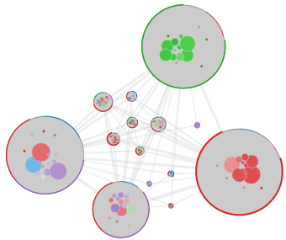
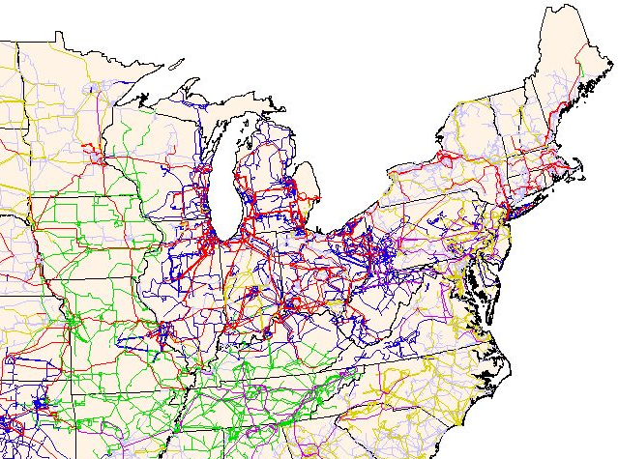
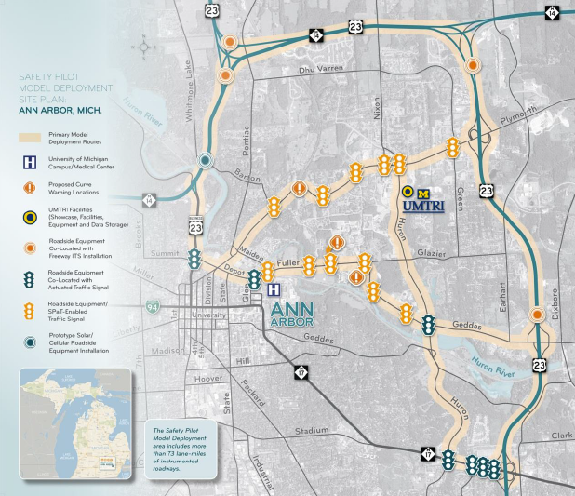
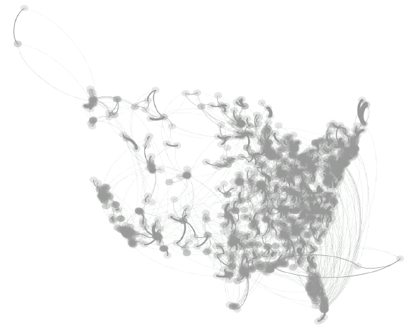
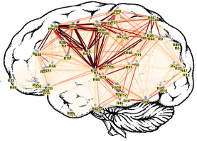
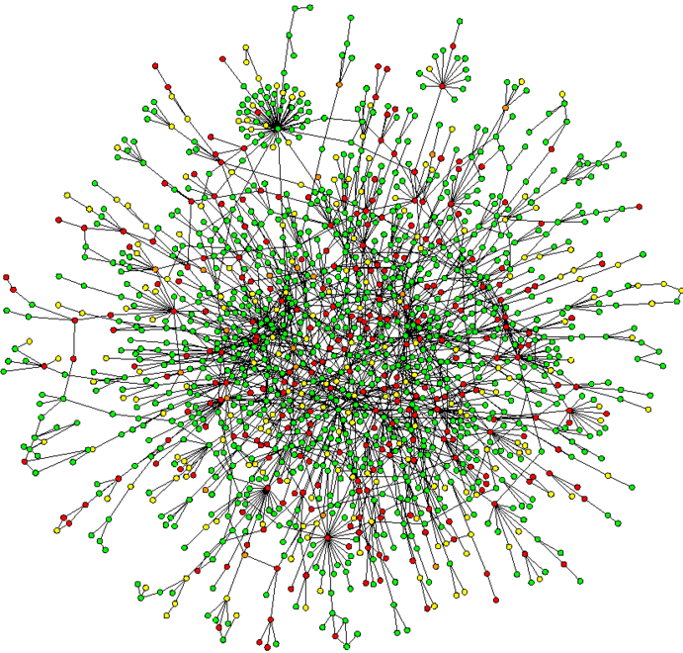
Observation: Graphs are everywhere!
Collaboration Networks
US Power Grid
Traffic Network
Brain Networks
Biological Networks
Hospital Networks

Slide 3
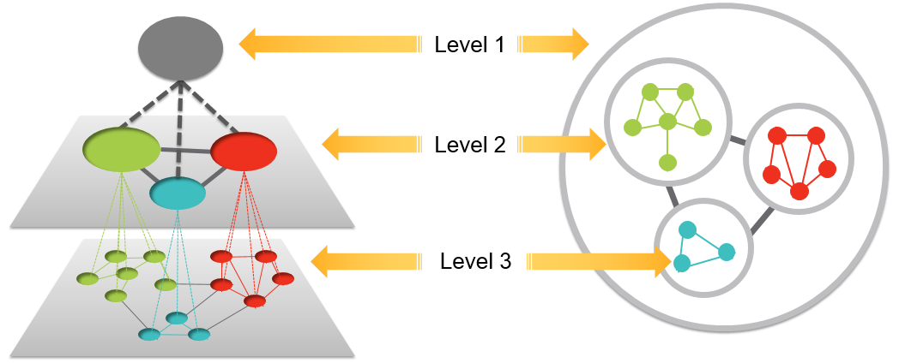
Graph Mining: An Overview
graph
subgraph
node/link
Observation: Mining stops at nodes/links (atom) level.
Q: Is there a level x (x=4, 5, …)? What is it?
Picture Credit: Nan Cao

Slide 4
A Motivating Example: Cross-Network Association
(e.g., candidate gene prioritization problem)
P
(Phenotype)
Problem Definition
  Given: (1) two networks P and G,
  and (2) their partial association A;
  Find: missing associations in A.
Solutions: Graph Ranking
  Given: a green node (disease);
  Find: the most relevant blue nodes (genes).
G
A
(PPI)
A Powerful Primitive in (A1) drug discovery; (A2) social recommendation; (3) QA post-tagging, etc.

Slide 5
A Motivating Example: Cross-Network Association
(e.g., candidate gene prioritization problem)
P
Problem Definition
  Given: (1) two networks P and G,
  and (2) their partial association A;
  Find: missing associations in A.
Solutions: Graph Ranking
  Given: a green node (disease);
  Find: the most relevant blue nodes (genes).
Limitations: Each green node (disease) might have its own PPI network!
A
G
O. Magger, Y. Y. Waldman, E. Ruppin, and R. Sharan. Enhancing the prioritization of disease-causing genes through tissue specific protein interaction networks. PLoS Computational Biology, 8(9), 2012.

Slide 6
A Motivating Example: Cross-Network Association
(e.g., candidate gene prioritization problem)
P
P
b
1
1
G₁
c
A
G
A
a
2
2
d
a
3
3
c
a
b
d
4
G₂
4
b
… …
… …
5
5
c
6
6
b
G₇
c
7
d
7
a
d
  A Disease Network P
  A PPI Network G
  A Disease Network P
  A set of tissue-specific PPI Networks G₁ ,…, G₇

Slide 7
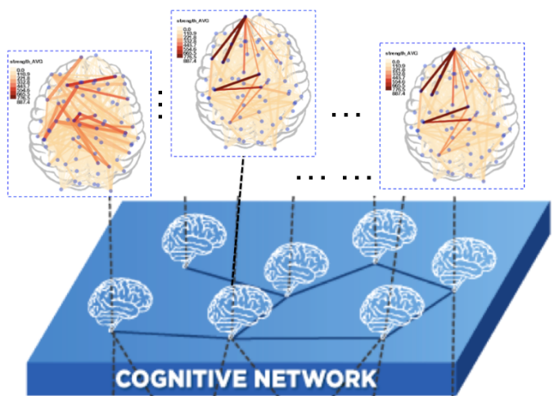
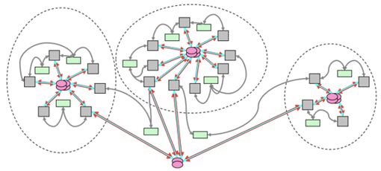
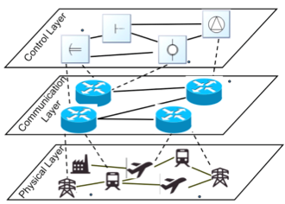
A Set of Networks: More Applications
Collaborations
Brain Networks
System of Systems
Cyber-Physics Systems

Slide 8
Roadmap
Motivations
NoN: A Network of Networks
  NoN Modeling
  NoN Mining
Beyond NoN

Slide 9
Modeling NoN
Q: How to represent a set of inter-connected networks (e.g., Tissue-Specific PPI Networks)?
P
b
1
G₁
c
A
a
2
d
3
c
a
b
d
4
G₂
… …
… …
5
6
b
G₇
c
7
a
d

Slide 10
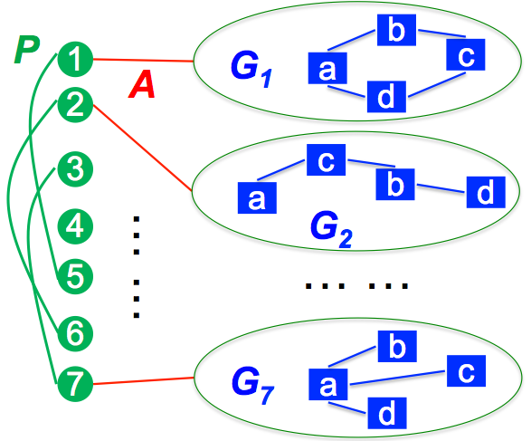
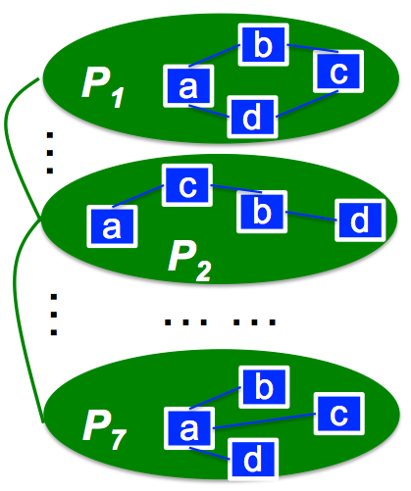
Introducing the NoN Model
A: each green node (disease) itself is a network
NoN (A Network of Networks) := a triplet R = <G, A, θ>
  G: Main Network (the green, disease to disease networks)
  A: Domain Networks (the blue, tissue-specific PPI networks)
  θ: Mapping function (each green, main node → a blue, domain network)
J. Ni, H. Tong, W. Fan, X. Zhang: Inside the atoms: ranking on a network of networks. KDD 2014
J. Ni, M. Koyuturk, H. Tong, J. Haines, R. Xu, X. Zhang: Disease gene prioritization by integrating tissue-specific molecular networks using a robust multi-network model. BMC bioinformatics 2016

Slide 11
NoN Models: Examples
NoN (A Network of Networks) := a triplet R = <G, A, θ>
  G: Main Network (the green, disease to disease networks)
  A: Domain Networks (the blue, tissue-specific PPI networks)
  θ: Mapping function (each green, main node → a blue, domain network)
Applications | The Main Network (G) | Domain Networks (A)
Gene-Pheno Assoc. | Disease Sim Network | Tissue-specific PPI Nets
LBSN | Geo-proximity network | Social Networks
Brain Initiative | Person-Person Network | Brain Networks
Team of Teams | Project Dependence Net | Team Networks
Scholarly Data | Res. Area Sim Network | Collaboration Networks

Slide 12

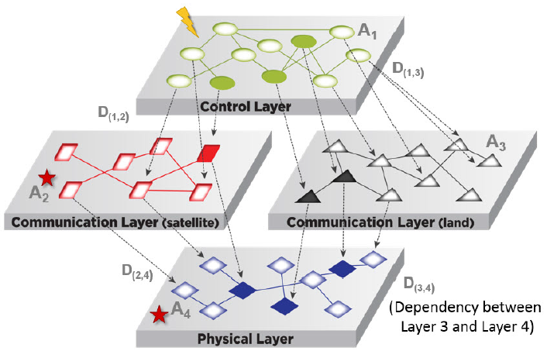
NoN - Generalizations
G1: Multi-layered NoN
  Candidate Gene Prioritization: Disease-tissue-protein
  Geo-social networks: City-district-person
G2: Soft Mapping function θ
  1-to-many, or many-to-many
C. Chen, J. He, N. Bliss and H. Tong: “On the Connectivity of Multi-layered Networks: Models, Measures and Optimal Control” ICDM 2015.

Slide 13
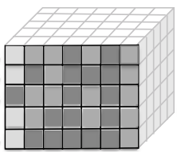
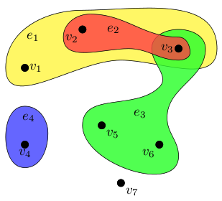
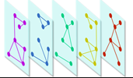
NoN vs. Some Popular Multi-Network Models
They are all special case of our NoN model!
  Tensor: a special NoN with
    A full clique main network (G);
    All domain networks (A) sharing the same node sets
  Hypergraph: a special NoN with
    All domain networks (A) being empty
  Multiplex: a special NoN with
    Two-layers
    All domain networks (A) sharing the same node sets

Slide 14
Roadmap
Motivations
NoN: A Network of Networks
  NoN Modeling
  NoN Mining: Ranking and Clustering
Beyond NoN
Some of Our Other Recent Work

Slide 15
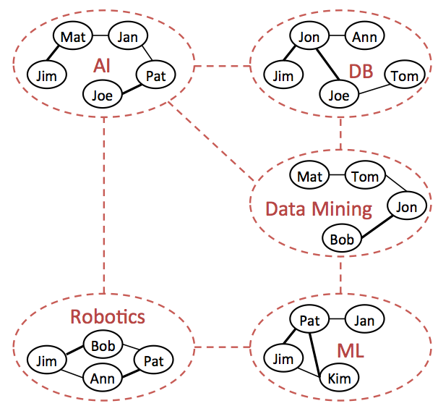
NoN Mining - Ranking
A1: Given a disease (e.g. P₁), what are the most relevant genes (blue nodes)?
A2: Who is most influential, considering both the within- and cross-area influence?

Slide 16
Ranking on a Single Network
Background
0.03
0.04
 | Node 4
Node 1 Node 2 Node 3 Node 4 Node 5 Node 6 Node 7 Node 8 Node 9 Node 10 Node 11 Node 12 | 0.13 0.10 0.13 0.22 0.13 0.05 0.05 0.08 0.04 0.03 0.04 0.02
10
0.10
9
12
0.13
2
0.08
0.02
1
8
0.13
11
3
0.04
4
0.05
6
5
0.13
7
0.05
Nearby nodes, higher scores
Ranking vector
More red, more relevant
H. Tong, C. Faloutsos, J.-Y. Pan: Fast Random Walk with Restart and Its Applications. ICDM 2006.
(best paper award at ICDM 2006, ICDM 2015 10-Yeart Highest Impact Paper Award)

Slide 17
Ranking on a Single Network
Background
0.03
0.04
 | Node 4
Node 1 Node 2 Node 3 Node 4 Node 5 Node 6 Node 7 Node 8 Node 9 Node 10 Node 11 Node 12 | 0.13 0.10 0.13 0.22 0.13 0.05 0.05 0.08 0.04 0.03 0.04 0.02
10
0.10
9
12
0.13
2
0.08
0.02
1
8
0.13
11
3
0.04
4
0.05
6
5
0.13
7
0.05
Nearby nodes, higher scores
Ranking vector
More red, more relevant
r_{i} = c x A x r_{i} + (1-c) x e_{i}
Footnote: “Maxwell Equation” for Web [Soumen Chakrabarti]

Slide 18
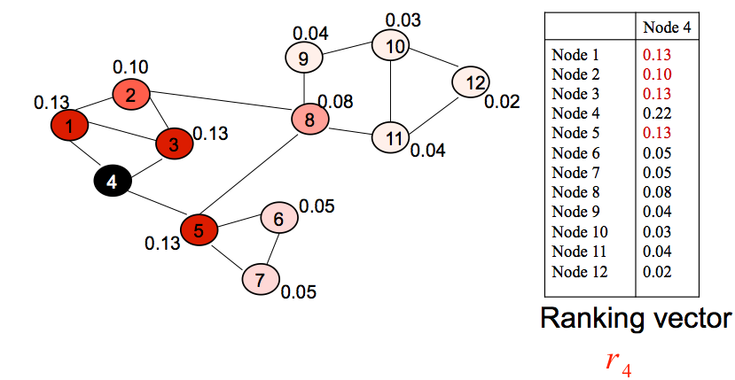
Ranking on a Single Network
Background
r_{i} = c x A x r_{i} + (1-c) x e_{i}
= argmin cr_{i}'(I – A)r_{i} + (1-c) x||r_{i} – e_{i}||²
Network Smoothness
Query Preference
An Optimization Viewpoint of “Maxwell Equation” for Web (Symmetric A)

Slide 19
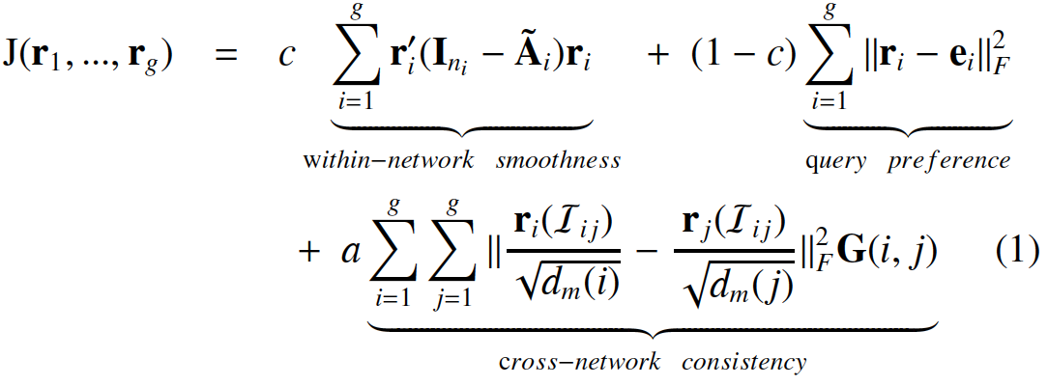
Ranking on NoN
Optimization Formulation:
Intuition:
  Similar ranking scores for an overlapped node, if their G(i,j) is high.
  A set of correlated g random walks
#1: within-network smoothness
#2: query preference
#2: query preference
#3: cross-network consistency
J. Ni, H. Tong, W. Fan, X. Zhang: Inside the atoms: ranking on a network of networks. KDD 2014
J. Ni, M. Koyuturk, H. Tong, J. Haines, R. Xu, X. Zhang: Disease gene prioritization by integrating tissue-specific molecular networks using a robust multi-network model. BMC bioinformatics 2016

Slide 20
Ranking on NoN
Optimization Formulation:
Equivalence: J(r) = J(r₁,…,r_{g})
  Intuition: a single R.W. on the integrated graph A
  Property: J(r) is positive-definite!
#1: within-network smoothness
#2: query preference
#3: cross-network consistency
~

Slide 21
Ranking on NoN
Equivalence: J(r) = J(r₁,…,r_{g})
  Intuition: One single random walk on the integrated graph A
  Property: J(r) is positive-definite!
Algorithms:
  #1: A linear algorithm → the optimal solution
  #2: Any existing fast solution on a single network
  #3: Further Speedup: O(T(m+ng)) → O(T(g log(g) + z))
    g << n; and z << m (key idea: using main network to do pruning)
~

Slide 22
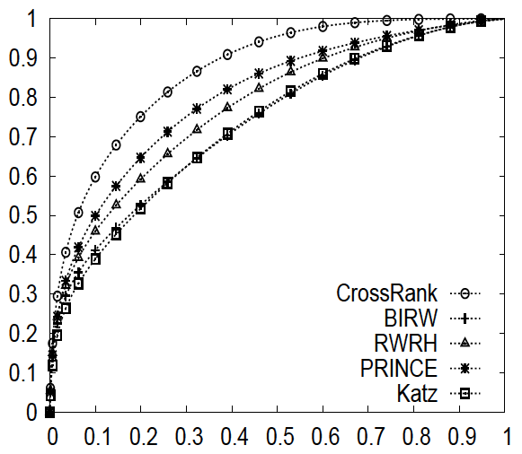
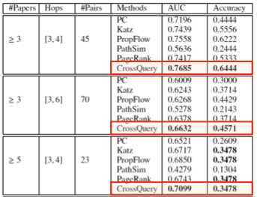
NoN Ranking - Results
A1: Candidate Gene Prioritization
Which genes are most relevant wrt disease a?
A2: Co-authorship Prediction
Which DM authors are most likely to collaborate with a given Med author?
Ours
ROC Curve Comparison
AUC and Accuracy

Slide 23
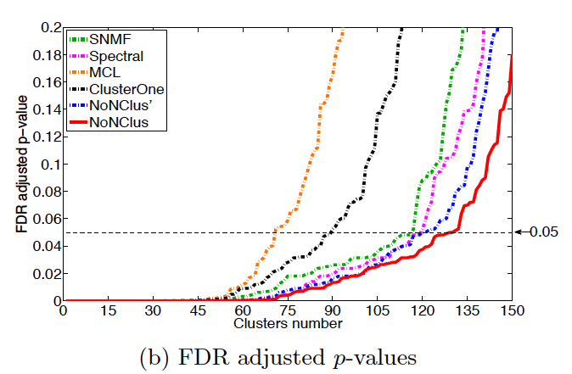
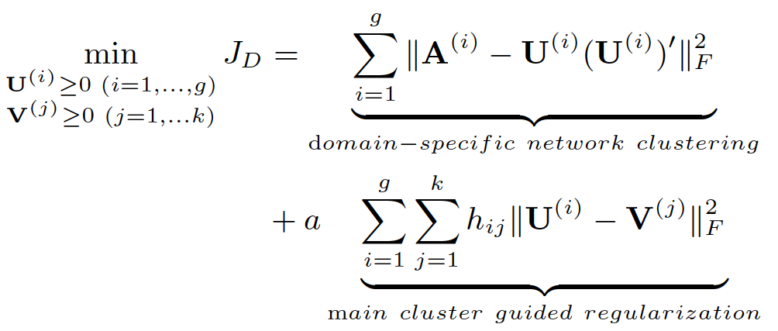
NoN Mining - Clustering
Results:
Obj. Function:
Similar Intuition !
P-value vs. (biologically meaningful) clusters
J. Ni, H. Tong, W. Fan, X. Zhang: Flexible and Robust Multi-Network Clustering. KDD 2015

Slide 24
Roadmap
Motivations
NoN: A Network of Networks
Beyond NoN: From NoN to NoX
  NOT
  iBall
  Fascinate

Slide 25
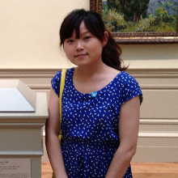
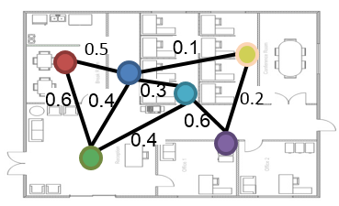
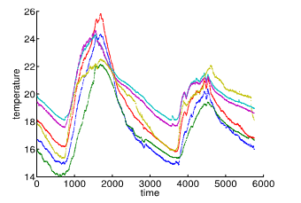
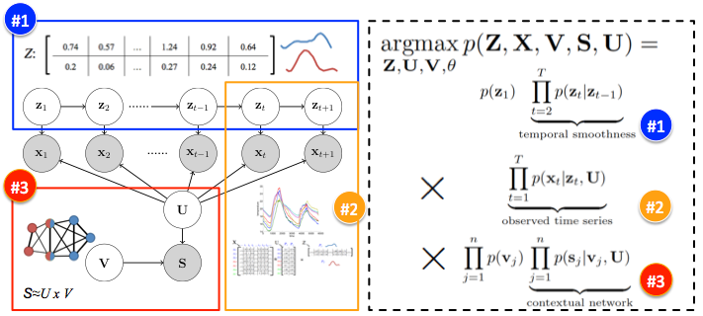
NoT: A Network of Time Series
Problem Definition
Results
Models &
Algorithms
Y. Cai, H. Tong, W. Fan and P. Ji: Fast Mining of a Network of Coevolving Time Series. SDM 2015.
Y. Cai, H. Tong, W. Fan, P. Ji, Q. He: Facets: Fast Comprehensive Mining of Coevolving High-order Time Series. KDD 2015

Slide 26

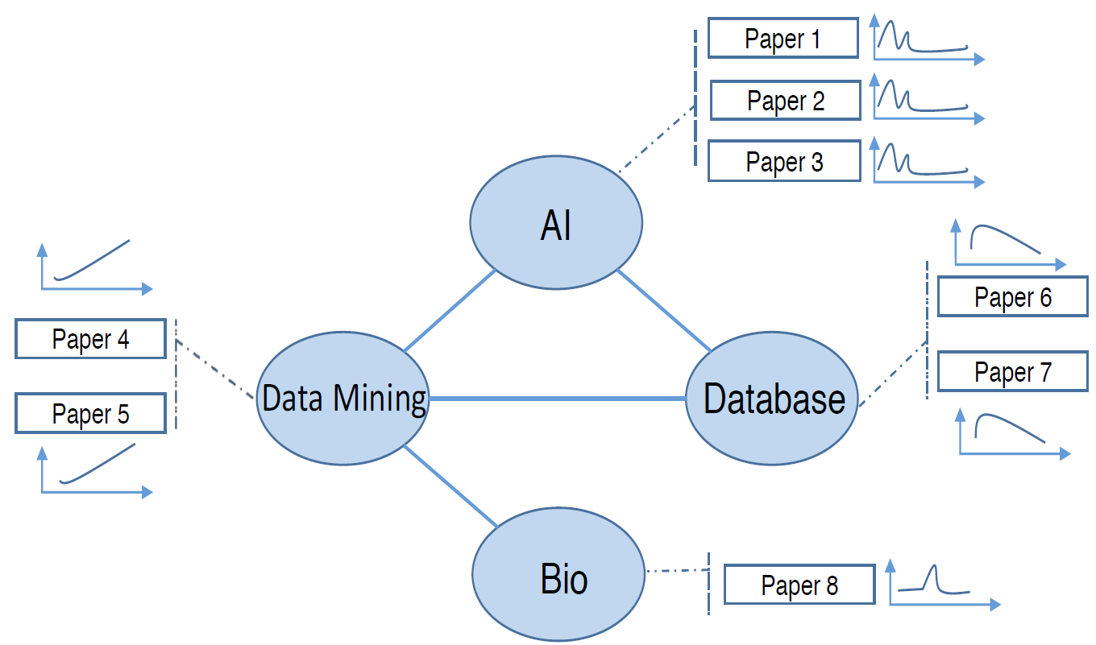
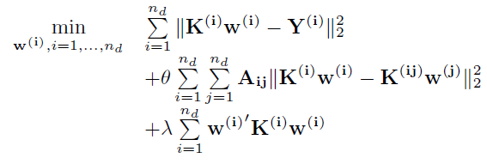
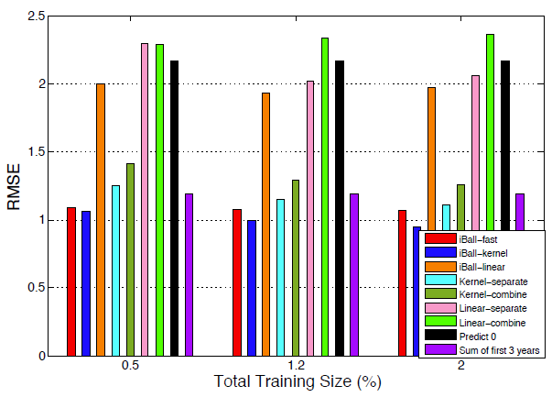
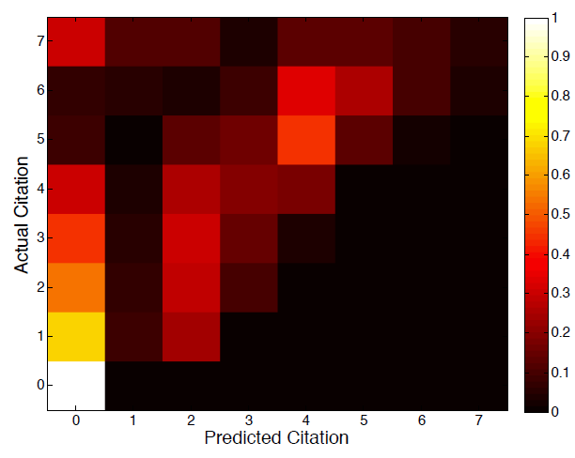
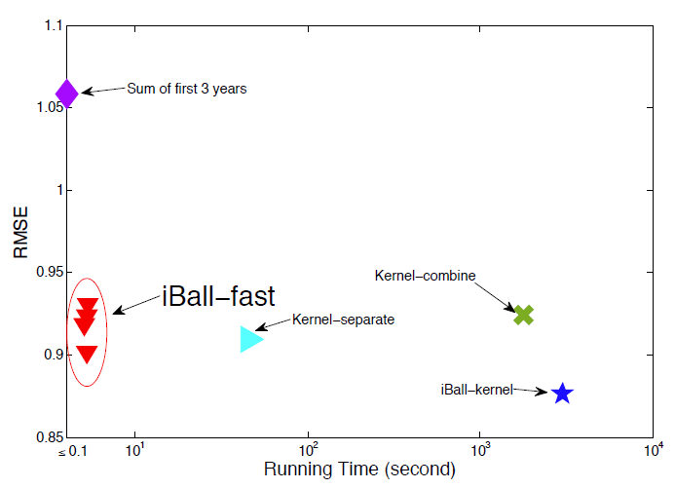
iBall: A Network of Regression Models
Problem Definition
Models & Algorithms
D1
D2
D4
D3
Results
Y. Yao, H. Tong, F. Xu, J. Lu: Scalable Algorithms for CQA Post Voting Prediction. TKDE 2017
L. Li, H. Tong, Y. Wang, C. Shi, N. Cao and N. Buchler: Is the Whole Greater Than the Sum of Its Parts? KDD 2017
L. Li, H. Tong: The Child is Father of the Man: Foresee the Success at the Early Stage. KDD 2015
Y. Yao, H. Tong, F. Xu, J. Lu: Predicting long-term impact of CQA posts: a comprehensive viewpoint. KDD 2014
“Data Mining Reveals the Secret to Getting Good Answers”, MIT Technology Review, 2013

Slide 27
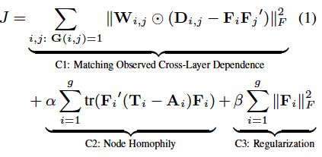
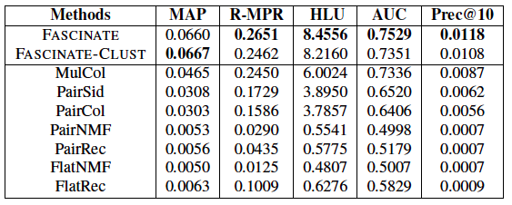
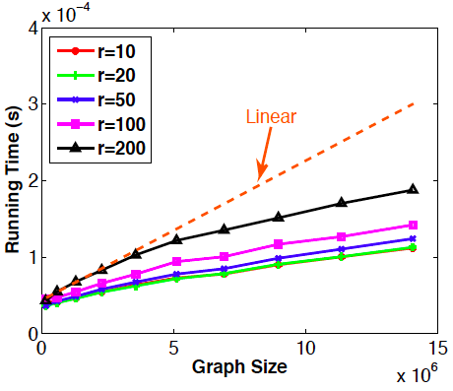
Fascinate: Cross-Layer Dependence Inference on Multi-Layered Networks
Problem Definition
Methods
Infer Unobserved Cross-Layer Links
Cross-Layer Inference = Collective CF
Results
Effectiveness
Efficiency
C. Chen, J. He, N. Bliss and H. Tong: “On the Connectivity of Multi-layered Networks: Models, Measures and Optimal Control” ICDM15.
C. Chen, H. Tong, L. Xie, L. Ying and Q. He: “FASCINATE: Fast Cross-Layer Dependence Inference on Multi-layered Networks”, KDD16, ‘Bests of KDD 2016’
C. Chen, H. Tong, L. Xie, L. Ying and Q. He: Cross-Dependency Inference in Multi-layered Networks: A Collaborative Filtering Perspective. ACM TKDD 2017

Slide 28
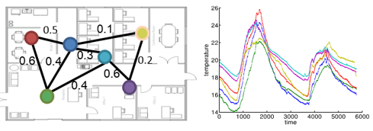
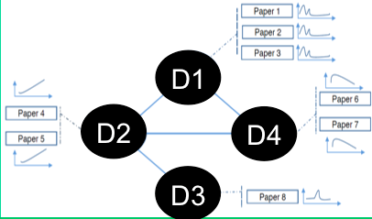
Conclusion: a Network of X
Summary
  NoN: Network + Networks
  NoT: Network + Time Series
  iBall: Network + Regression
  Fascinate: Network + Inference
Take Home Messages
  Modeling: `No’ (i.e., a Network of X) as the answer
    Networks as data → as context
  Algorithms: Networks as the contextual regularizer

Slide 29
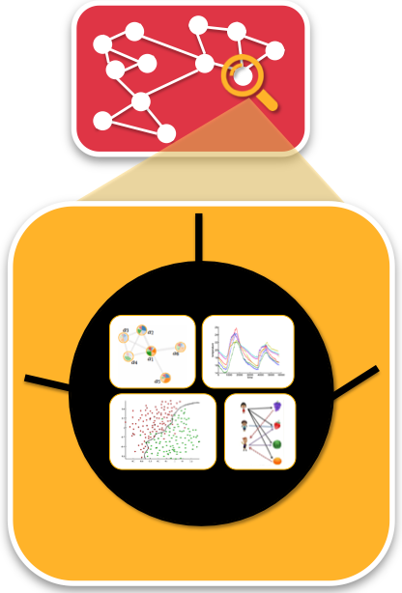
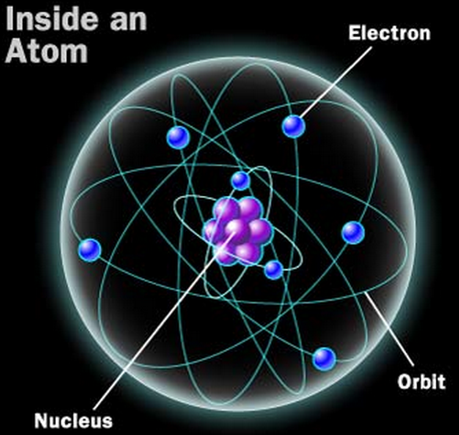












Joint work with Nadya Bliss, Norbou Buchler, Nan Cao, Kate Ehrlich, Wei Fan, Ping Ji, Qing He, Danai Koutra, Yu-Ru Lin, Conglei Shi, Lei Xie, Yuan Yao, Yong Wang, Feng Xu, Lei Ying, Xiang Zhang and more
Inside the atom is a whole new world!
“A whole new world
Every turn a surprise
With new horizons to pursue
Every moment red-letter
……”
Supported by

