Slide 1
Optimal Connectivity on Big Graphs:
Measures, Algorithms and Applications
Hanghang Tong
hanghang.tong@asu.edu
http://tonghanghang.org

Slide 2
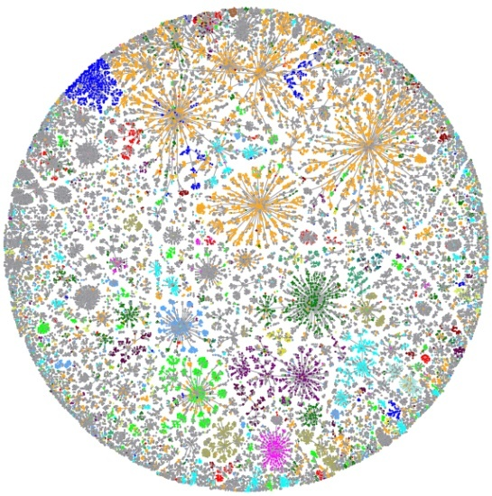
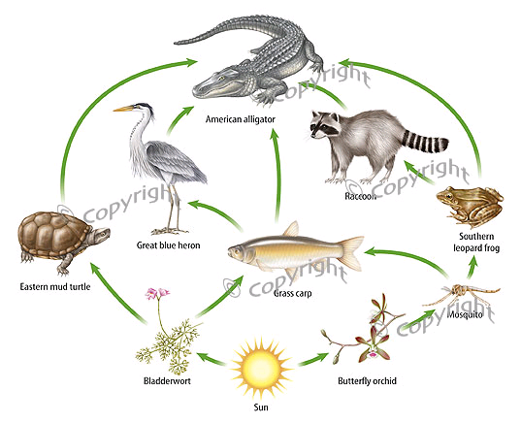
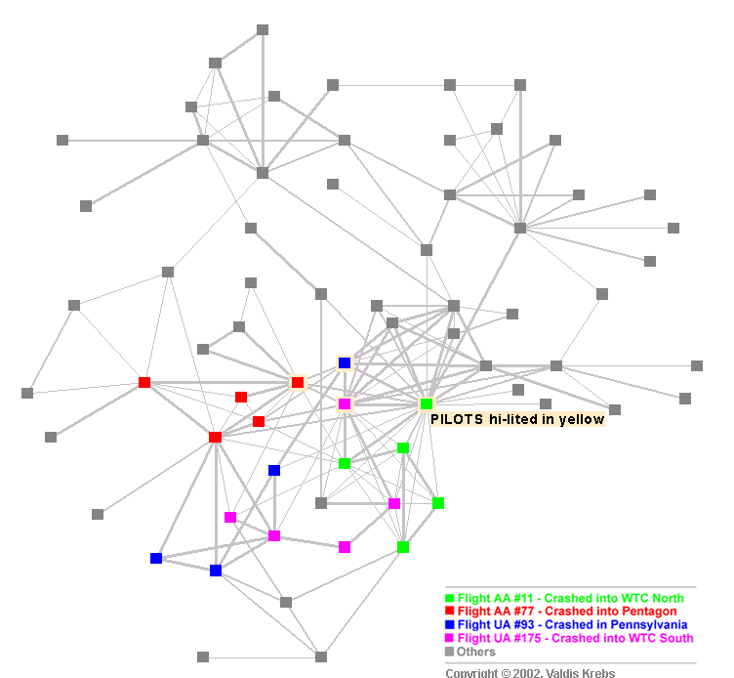
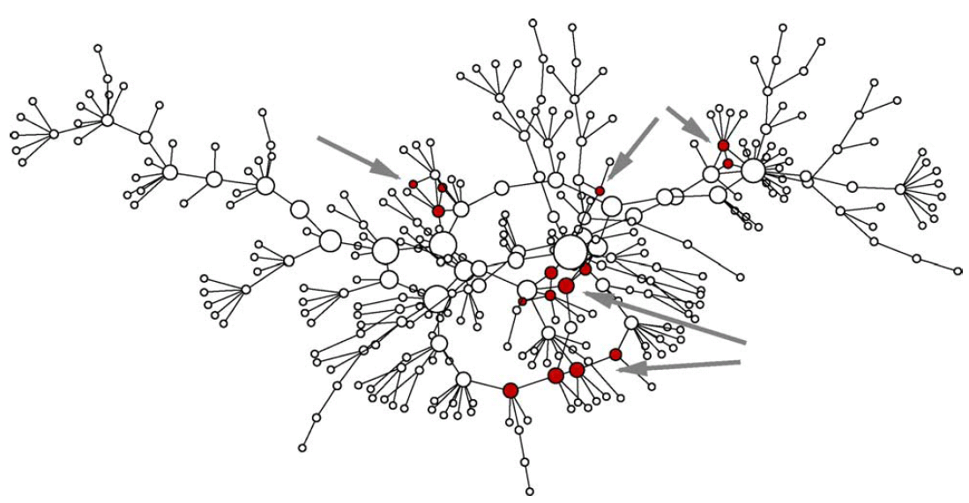
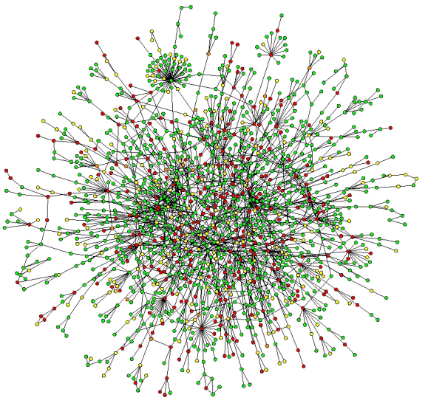
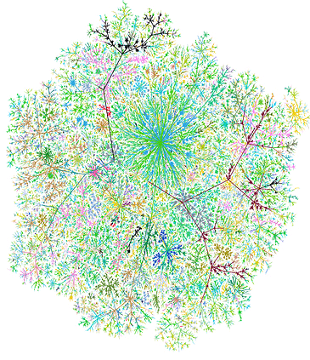
Observation: Graphs are everywhere!
-----
Internet Map [Koren 2009]
Food Web [2007]
Terrorist Network
[Krebs 2002]
Goal: understand and utilize graph data
Challenges: real graphs are often BIG!
Social Network
[Newman 2005]
Protein Network
[Salthe 2004]
Web Graph

Slide 3
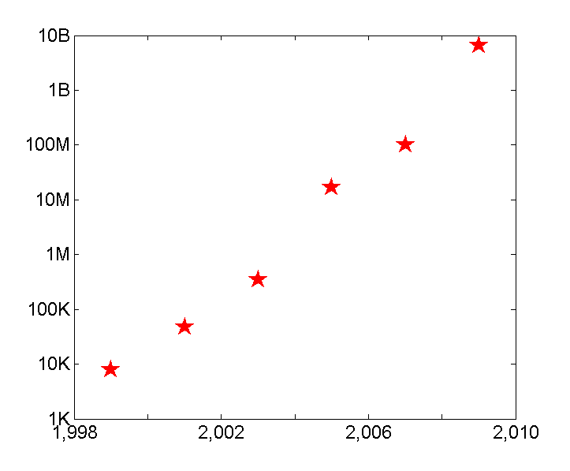
BIG Graphs #1: The Size of Graphs is Growing!
10B
Web Link
[Kang 2009]
100M
NetFlix Rating [Koren 2007]
Patent Citation [Leskovec 2005]
# of edges
(Log Scale)
Paper Citation [Chakrabarti 2003]
100K
Co-authorship [Newman 2001]
Internet Routing [Faloutsos 1999]
Year
1000
1,000
Q: How to Speed-up & Scale-up?
3
Notes:
3

Slide 4
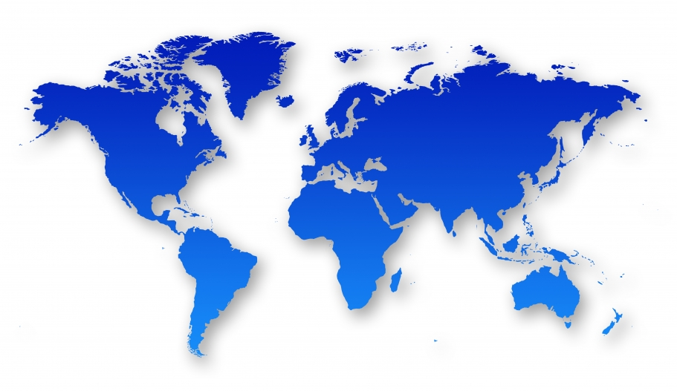
BIG Graphs #2: Data Complexity
(Rich graphs, e.g., geo-coded, attributed)
Node Attr.
Teenager
Adult
Phone
telemarketer
MSN
Edge Attr.
Q: What is difference between North America and Asia?; How to find patterns? (e.g., anomalies, communities, etc)
4
Notes:
4

Slide 5
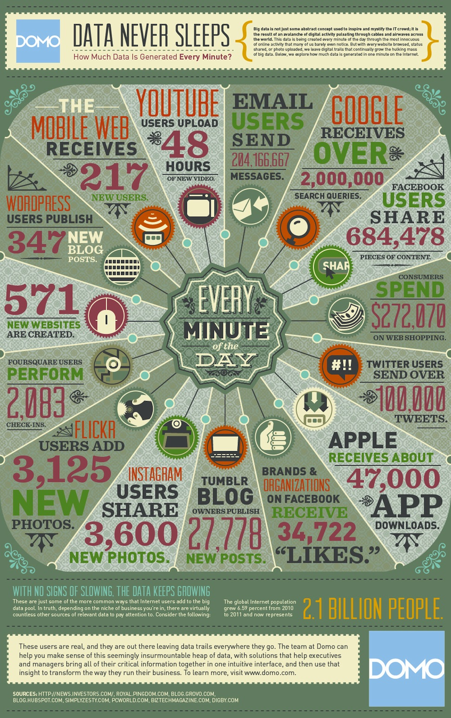
BIG Graphs #3: High Volatility
The amount of the data that is created every one minute
Q: How to respond in real-time or near-real time?
Notes:
How much data is created every one minute?
June 22, 2012, www.marshable.com
Nearly 300,000 status updates are posted to Facebook every minute
Twitter users average over 100,000 tweets per minute
Average day search on google: http://www.statisticbrain.com/google-searches/

Slide 6
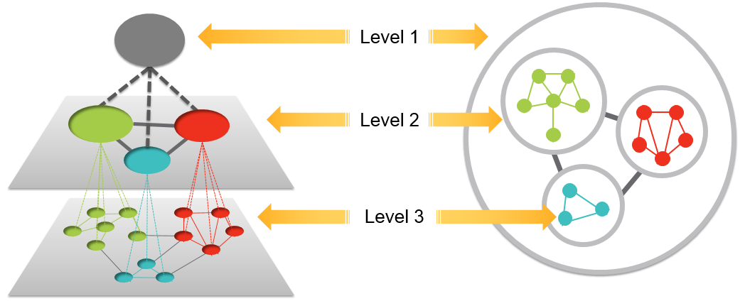
Graph Mining: An Overview
graph
subgraph
node/link
Q: Where does the graph come from?

Slide 7
A Typical Graph Mining Paradigm
Graphs
Patterns
Graph Connectivity Optimization (GCO) - This Tutorial
Given:
(1) an initial graph
(2) a graph operation
(3) a mining task
Find:
an ‘optimal’ graph
Graph operation: deleting 10 nodes; adding 5 links; etc.
Mining tasks: contain the virus; maximize the traffic flow

Slide 8

Dissemination: Think of it as Wine Spill
GCO: Why Do We Care?
Spill a drop of wine on cloth
Spread/disseminate to the neighborhood

Slide 9

Dissemination: Wine Spill on a Graph
GCO: Why Do We Care?
9
10
2
12
1
8
3
11
4
5
6
Initial Node
7
wine spill on cloth
Dissemination on a graph
Same Diffusion Eq.
- 9 -

Slide 10


An Example: Virus Propagation/Dissemination
Sick
Healthy
Contact

Slide 11

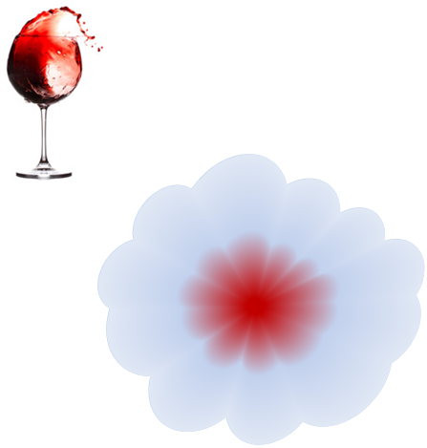
An Example: Virus Propagation/Dissemination
Sick
Healthy
Contact
1: Sneeze to neighbors
2: Some neighbors → Sick
3: Try to recover
Similar Diffusion Eq.
11

Slide 12
An Example: Virus Propagation/Dissemination
Sick
Healthy
Contact
1: Sneeze to neighbors
2: Some neighbors → Sick
3: Try to recover
Q: How to minimize infected population?

Slide 13
An Example: Virus Propagation/Dissemination
Sick
Healthy
Contact
1: Sneeze to neighbors
2: Some neighbors → Sick
3: Try to recover
Q: How to minimize infected population?
- Q1: Understand tipping point
- Q2: Affecting algorithms

Slide 14
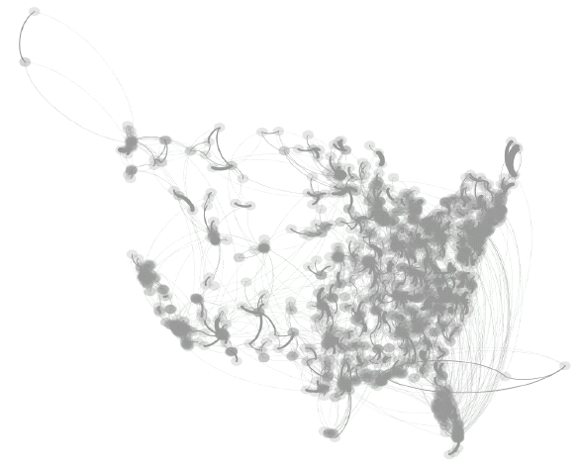
Why Do We Care? – Healthcare
US-Medicare Network
Critical Patient transferring
Move patients → specialized care
→ highly resistant micro-organism → Infection controlling → costly & limited
Q: How to allocate resource to minimize overall spreading?
SARS costs 700+ lives; $40+ Bn; H1N1 costs Mexico $2.3bn; Flu 2013: one of the worst in a decade, 105 children in US.

Slide 15
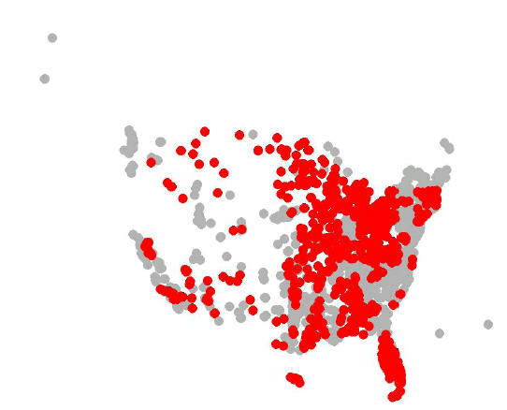
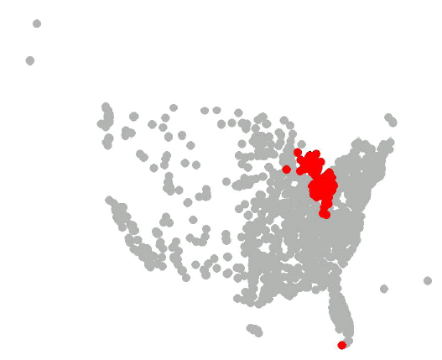
Why Do We Care? – Healthcare
Current Method
Our Method
Red: Infected Hospitals after 365 days
B. Aditya Prakash, Lada Adamic, Theodore Iwashnya, Hanghang Tong and Christos Faloutsos: Fractional Immunization on Networks. SDM 2013

Slide 16
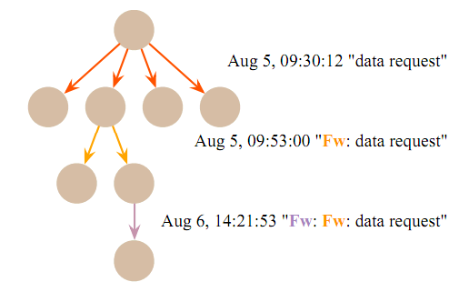
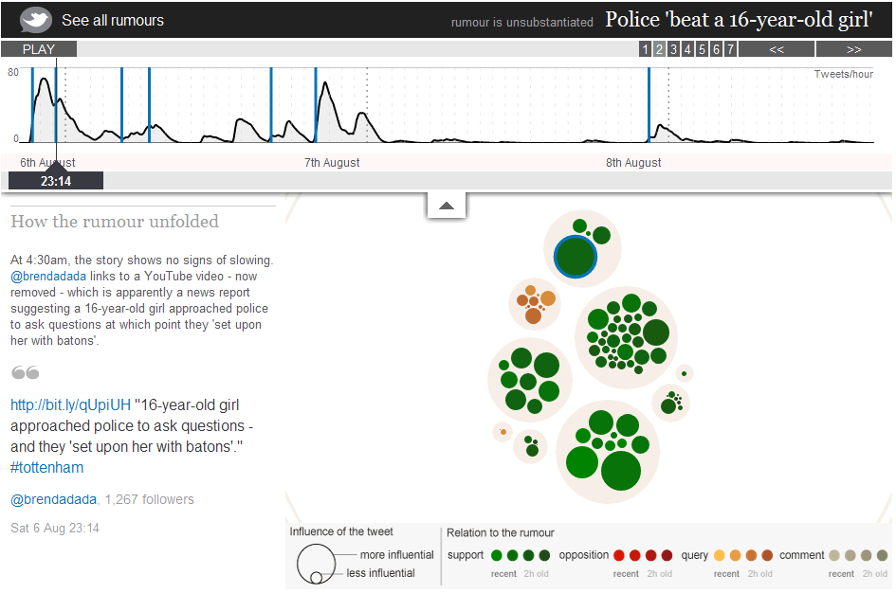
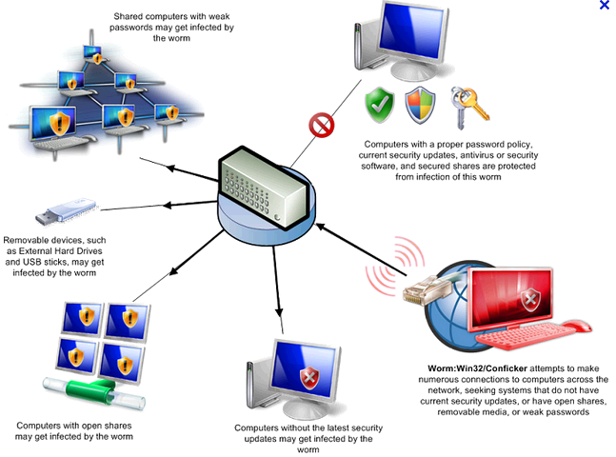
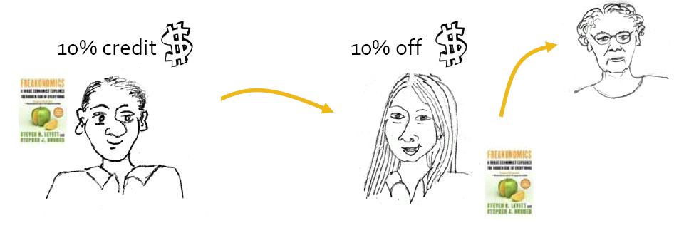
Why Do We Care? (More)
Email Fwd in Organization
Rumor Propagation
Viral Marketing
Malware Infection
Notes:
http://www.guardian.co.uk/uk/interactive/2011/dec/07/london-riots-twitter

Slide 17
Roadmap
Motivations and Background
Part I: GCO Measures
Part II: GCO Theories & Algorithms
Part III: GCO Applications
Part IV: Open Challenges & Future Trends

Slide 18
Part I: GCO Measures
GCO Measure #1: Epidemic Threshold (λ)
GCO Measure #2: Graph Robustness
Other GCO Measures
Comparison of GCO Measures
Unification of GCO Measures
- 18 -

Slide 19







SIS Model (e.g., Flu)
(Susceptible-Infected-Susceptible)
Each Node Has Two Statuses:
β: Infection Rate (Prob ( | || ))
δ: Recovery Rate (Prob ( | | ))
Sick
Healthy
t = 1
t = 2
t = 3

Slide 20
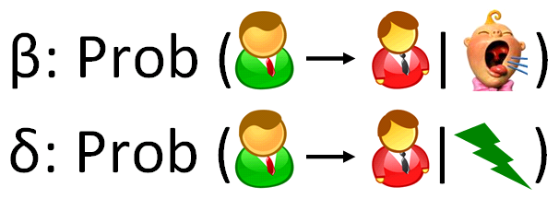
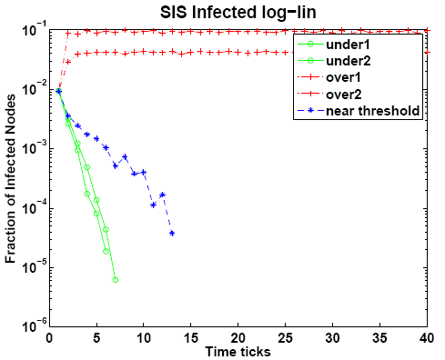
SIS Model (e.g., Flu)
p_{t+1} = H (p_{t})
Infection Ratio
Theorem [Chakrabarti+ 2003, 2007]:
Ifλ x (β/δ) ≤ 1; no epidemic
for any initial conditions of the graph)
, δ : virus par
Time Ticks
λ: largest eigenvalue of the graph (~ connectivity of the graph)
β, δ : virus parameters (~strength of the virus)

Slide 21








Beyond Static Graphs: Alternating Behavior
DAY
(e.g., work, school)
A₁: adjacency matrix
8
8
B. Aditya Prakash, Hanghang Tong, Nicholas Valler, Michalis Faloutsos, Christos Faloutsos:Virus Propagation on Time-Varying
Networks: Theory and Immunization Algorithms. ECML/PKDD (3) 2010: 99-114
Nicholas Valler, B. Aditya Prakash, Hanghang Tong, Michalis Faloutsos, Christos Faloutsos:Epidemic Spread in Mobile Ad Hoc
Networks: Determining the Tipping Point. Networking (1) 2011: 266-280
21

Slide 22
Beyond Static Graphs: Alternating Behavior
NIGHT
(e.g., home)
A₂: adjacency matrix
8
8
B. Aditya Prakash, Hanghang Tong, Nicholas Valler, Michalis Faloutsos, Christos Faloutsos:Virus Propagation on Time-Varying
Networks: Theory and Immunization Algorithms. ECML/PKDD (3) 2010: 99-114
Nicholas Valler, B. Aditya Prakash, Hanghang Tong, Michalis Faloutsos, Christos Faloutsos:Epidemic Spread in Mobile Ad Hoc
Networks: Determining the Tipping Point. Networking (1) 2011: 266-280

Slide 23



Formal Model Description
[PKDD 2010, Networking 2011]
Healthy
SIS model
  recovery rate δ
  infection rate β
Set of T arbitrary graphs
Prob. δ
N2
Prob. β
N1
X
Prob. β
Prob. δ
Infected
N3
day
night
N
N
, weekend…..
N
N

Slide 24
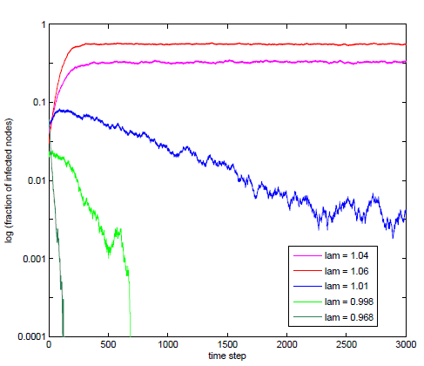
Epidemic Threshold for Alternating Behavior
[PKDD 2010, Networking 2011]
Theorem [PKDD 2010, Networking 2011]:
No epidemic Ifλ(S) ≤ 1.
Log (Infection Ratio)
Above
System matrix S = Π_{i} S_{i}
S_{i} = (1-δ)I + β A_{i}
At Threshold
Below
day
night
A_{i}
N
N
……
Time Ticks
Also generalize to other 25
virus propagation models
N
N
24

Slide 25
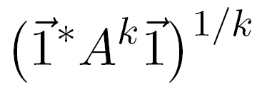
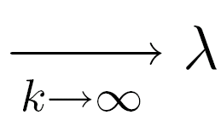
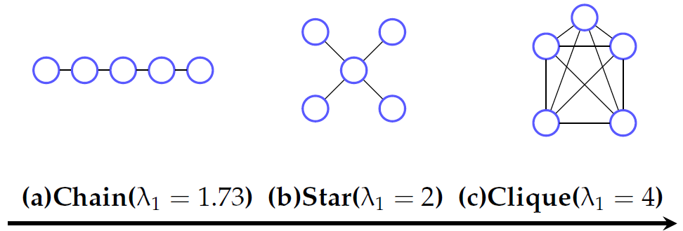
Why is λ So Important?
Intuitions
λ → Path Capacity of a Graph:
1
1
2
1
2
2
Larger λ → better connected

Slide 26
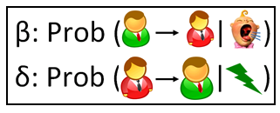
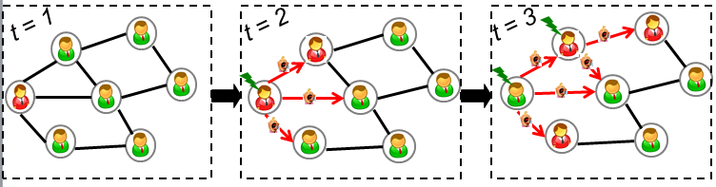
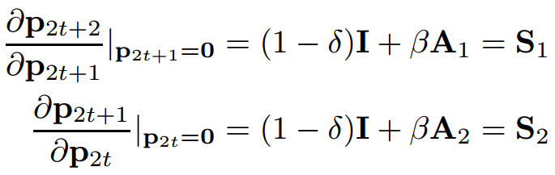
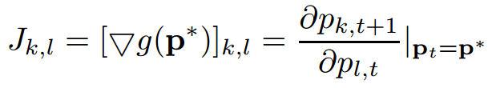
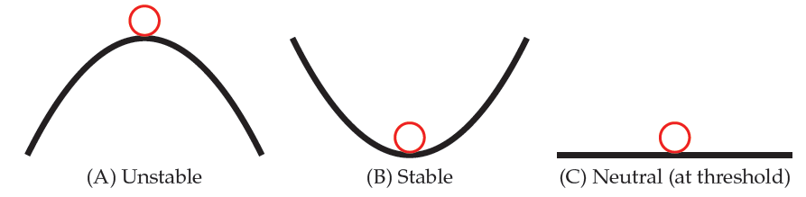
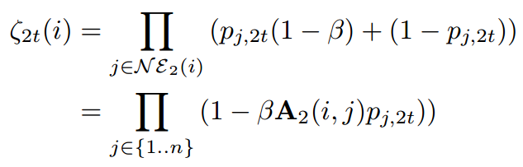
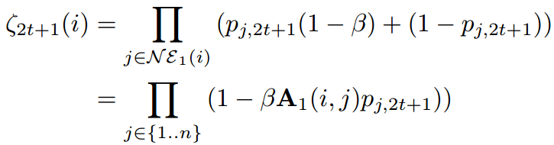
Why is λ So Important?
Details
Key 1: Model Dissemination as an NLDS:
Key 2: Asymptotic Stability of NLDS:
p = p* = 0 is asymptotic stable if | λ (J)|<1, where
p_{t+1} = g (p_{t})
p_{t} : Prob. vector: nodes being sick at t
g : Non-linear function (graph + virus parameters)
26
Notes:
\e_t(i): probability of node I does not receive any infection from neighborhood at time t

Slide 27
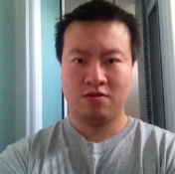

Beyond λ: Graph/Network Robustness
Robustness is the ability of a network to continue performing well when it is subject to failures or attacks.
  random failure (server down)
  cascading failure (virus propagating)
  targeted attack (carefully-chosen agents down)
How to measure the robustness of a given network?
  interpretable
  (strictly) monotonic
  captures redundancy
Hau Chan, Leman Akoglu, Hanghang Tong: Make It or Break It: Manipulating Robustness in Large Networks. SDM 2014: 325-333

Slide 28
Beyond λ: Graph/Network Robustness
Study of robustness:
  mathematics, physics, computer science, biology
A long (!) and profoundly diverse list of measures:
  vertex/edge connectivity
  avg. shortest distance
  max. shortest distance (diameter)
  efficiency
  vertex/edge betweenness
  clustering coefficient
  largest component fraction/avg. component size
  total pairwise connectivity
  average available flows
Hau Chan, Leman Akoglu, Hanghang Tong: Make It or Break It: Manipulating Robustness in Large Networks. SDM 2014: 325-333

Slide 29


Beyond λ: Graph/Network Robustness
…
algebraic connectivity
effective resistance
number of spanning trees
  principal eigenvalue
  spectral gap
  natural connectivity
other (combinatorial) measures:
  toughness, scattering number, tenacity, integrity, fault diameter, isoperimetric number, min balanced cut, restricted connectivity, …
eigenvalues
of the Laplacian L
eigenvalues
of the adjacency A
Hau Chan, Leman Akoglu, Hanghang Tong: Make It or Break It: Manipulating Robustness in Large Networks. SDM 2014: 325-333

Slide 30
Beyond λ: Graph/Network Robustness
…
algebraic connectivity
effective resistance
number of spanning trees
  principal eigenvalue
  spectral gap
  natural connectivity
other (combinatorial) measures:
  toughness, scattering number, tenacity, integrity, fault diameter, isoperimetric number, min balanced cut, restricted connectivity, …
eigenvalues
of the Laplacian L
eigenvalues
of the adjacency A
Hau Chan, Leman Akoglu, Hanghang Tong: Make It or Break It: Manipulating Robustness in Large Networks. SDM 2014: 325-333

Slide 31
A “guide” for “good” robustness measures
Strict monotonicity
  improves strictly when edges are added
  *related: differentiates graphs
Redundancy
  accounts for alternative/back-up paths
Stability
  does not change drastically by small changes
  *related: meaningful for disconnected graphs
Interpretability
  its meaning is intuitively clear
Hau Chan, Leman Akoglu, Hanghang Tong: Make It or Break It: Manipulating Robustness in Large Networks. SDM 2014: 325-333

Slide 32





A “guide” for “good” robustness measures
Measures | S. Monotone | Redundant | Stable | Interpretable
vertex / edge connectivity
avg. shortest distance
diameter
efficiency
vertex / edge betweenness
clustering coefficient
largest component fraction
total pairwise connectivity
avg. available flows
algebraic connectivity
effective resistance
number of spanning trees
spectral radius / gap
natural connectivity
Hau Chan, Leman Akoglu, Hanghang Tong: Make It or Break It: Manipulating Robustness in Large Networks. SDM 2014: 325-333

Slide 33
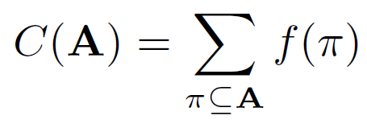
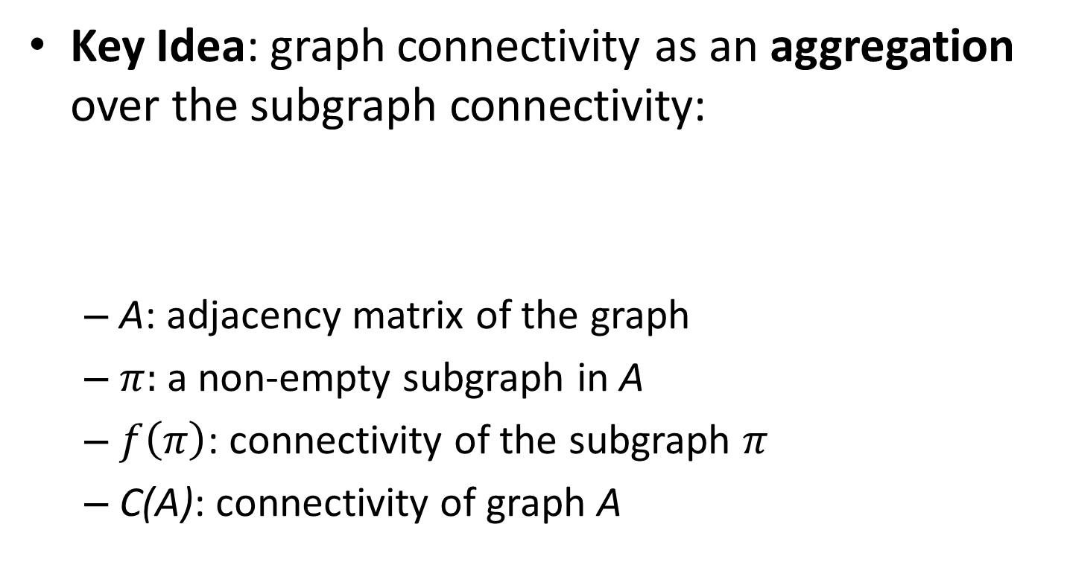
Unification of Connectivity Measures
Key Idea: graph connectivity as an aggregation over the subgraph connectivity:
  A: adjacency matrix of the graph
  $π:$a non-empty subgraph in A
  $f\left(π\right)$: connectivity of the subgraph $π$
  C(A): connectivity of graph A
Chen Chen, Jingrui He, Nadya Bliss, Hanghang Tong: On the Connectivity of Multi-layered Networks: Models, Measures and Optimal Control. ICDM 2015

Slide 34
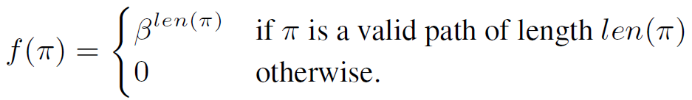
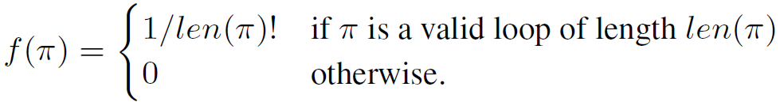
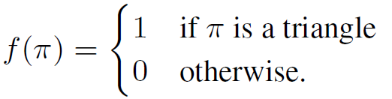
Unification of Connectivity Measures
Key Idea:
Examples
  Path Capacity:
  Loop Capacity:
  Triangle Capacity:
  …
Chen Chen, Jingrui He, Nadya Bliss, Hanghang Tong: On the Connectivity of Multi-layered Networks: Models, Measures and Optimal Control. ICDM 2015

Slide 35
Roadmap
Motivations and Background
Part I: GCO Measures
Part II: GCO Theories & Algorithms
Part III: GCO Applications
Part IV: Open Challenges & Future Trends
- 35 -

Slide 36

Minimizing Dissemination: Immunization
Given: a graph A, virus prop model and budget k;
Find: k ‘best’ nodes for immunization.
23
16
24
15
12
14
25
22
13
26
11
21
27
9
34
20
10
1
28
4
8
33
19
2
29
3
7
18
5
30
6
17
31
32
36
SARS costs 700+ lives; $40+ Bn; H1N1 costs Mexico $2.3bn
Notes:
36

Slide 37

Minimizing Dissemination: Immunization
Given: a graph A, virus prop model and budget k;
Find: k ‘best’ nodes for immunization.
23
16
24
15
12
14
25
22
13
26
11
21
27
9
34
20
10
1
28
4
8
33
19
2
29
3
7
18
5
30
6
17
31
32
37
SARS costs 700+ lives; $40+ Bn; H1N1 costs Mexico $2.3bn
Notes:
37

Slide 38
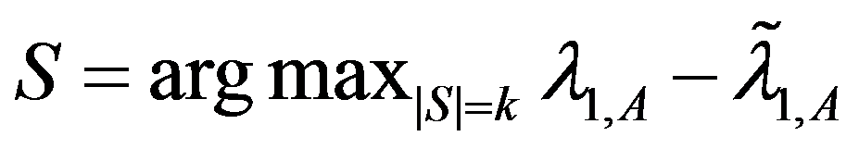
Optimal Method
Select k nodes, whose absence creates the largest drop in λ
λ-λ_{s}
9
9
11
9
10
10
1
1
4
4
8
8
2
2
3
7
3
7
5
5
6
6
Original Graph: λ
Without {2, 6}: λ_{s}
- 38 -

Slide 39
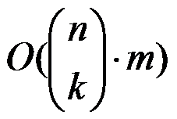
Optimal Method
Select k nodes, whose absence creates the largest drop in λ
But, we need in time
  Example: 1,000 nodes, with 10,000 edges
    It takes 0.01 seconds to compute λ
    It takes 2,615 years to find best-5 nodes !
λ-λ_{s}
Largest eigenvalue
w/o subset of nodes S
Theorem: Find Optimal k-node Immunization is NP-Hard
C. Chen, H. Tong, B. Prakash, C. Tsourakakis, T. Eliassi-Rad, C. Faloutsos, D. Chau: Node Immunization on Large Graphs: Theory and Algorithms. IEEE TKDE 2015

Slide 40
Details
Optimal k-node immunization is NP-Hard
Basic Idea: Reduction from P1 (known NP-hard)
Proof #1: If YES to P1(G,k)→ YES to P2(G, n-k)
  YES to P1 S_{kxk} = 0 λ(A) = λ(0) = 0 YES to P2
Proof #2: If NO to P1(G,k)→ NO to P2(G, n-k)
Suppose YES to P2 λ(A) = λ(0) ≤ 0
S_{kxk} = 0 Nodes in S being ind. set contradict
Given an undirected/unweighted graph G, and k
P1 (k-independent set problem): is there k nodes, no two of which are adjacent?
P2 (k-node immunization problem): is there k nodes, the deletions of which makes the leading eigenvalues ≤ 0
S_{kxk}
X_{(k)x(n-k)}
A =
X_{(k)x(n-k)}
T_{(n-k)x(n-k)}
Removing
Nodes in T
~
Removing
Nodes in T
~
S(i,j)≥0

Slide 41
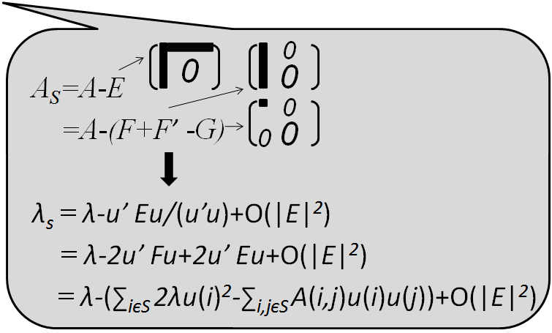
Netshield to the Rescue
Theorem:
(1) λ - λ_{s}≈Sv(S)= ∑_{iєS} 2λu(i)²-∑_{i,jєS} A(i,j)u(i)u(j)
A
u
u
=λ X
Footnote:
u(i) ~ PageRank(i) ~
in-degree(i)
u(i): eigen-score
C. Chen, H. Tong, B. Prakash, C. Tsourakakis, T. Eliassi-Rad, C. Faloutsos, D. Chau: Node Immunization on Large Graphs: Theory and Algorithms. IEEE TKDE 2015

Slide 42
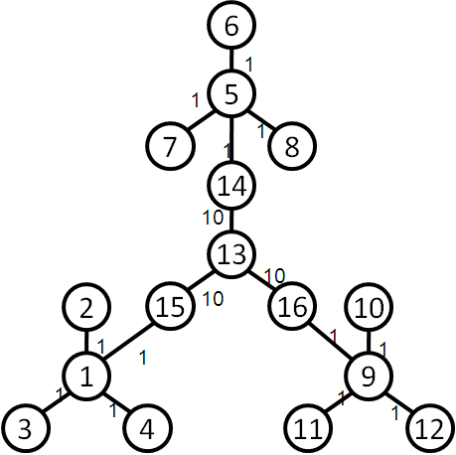
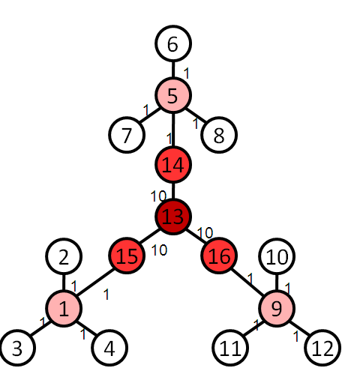
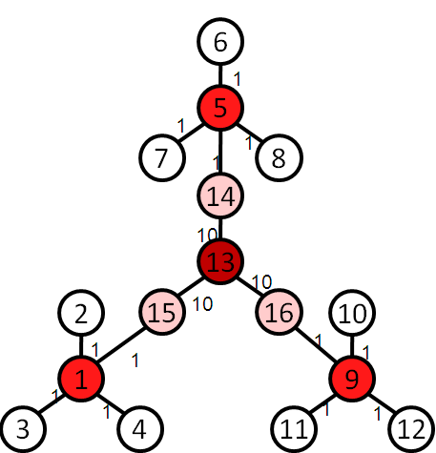
Netshield to the Rescue
Intuition
Theorem:
(1) λ - λ_{s}≈Sv(S)= ∑_{iєS} 2λu(i)²-∑_{i,jєS} A(i,j)u(i)u(j)
find a set of nodes S (e.g. k=4), which
  (C1) each has high eigen-scores
  (C2) diverse among themselves
Original Graph
Select by C1
Select by C1+C2

Slide 43
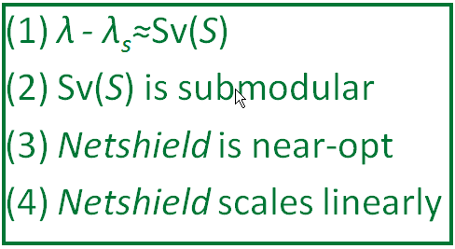
Netshield to the Rescue
Theorem:
(1) λ - λ_{s}≈Sv(S)= ∑_{iєS} 2λu(i)²-∑_{i,jєS} A(i,j)u(i)u(j)
(2) Sv(S) is sub-modular (+monotonically non-decreasing)
Example: 1,000 nodes, with 10,000 edges
  Netshield takes < 0.1 seconds to find best-5 nodes !
  … as opposed to 2,615 years
Corollary:
(3) Netshield is near-optimal (wrt max Sv(S))
(4) Netshield is O(nk²+m)
43
Footnote: near-optimal means Sv(S ^{Netshield}) >= (1-1/e) Sv(S ^{Opt})

Slide 44

Why Netshield is Near-Optimal?
Marginal benefit of deleting {5,6}
Marginal benefit of deleting {5,6}
9
3
10
9
3
1
10
5
1
δ
5
2
6
8
7
2
6
8
7
4
4
Benefit of deleting {1,2}
Benefit of deleting {1,2, 3,4}
>=
Sub-Modular (i.e., Diminishing Returns)
δ
Notes:
44

Slide 45
Why Netshield is Near-Optimal?
9
3
10
9
3
1
10
5
1
δ
5
2
6
8
7
2
6
8
7
4
4
>=
Sub-Modular (i.e., Diminishing Returns)
δ
Theorem: k-step greedy alg. to maximize a sub-modular function guarantees (1-1/e) optimal [Nemhauster+ 78]
Notes:
45

Slide 46
Why Sv(S) is sub-modular?
Newly deleted
9
3
10
1
5
2
6
8
7
4
Already deleted
H. Tong, B. Prakash, C. Tsourakakis, T. Eliassi-Rad, C. Faloutsos, D. Chau: On the Vulnerability of Large Graphs. ICDM 2010: 1091-1096
C. Chen, H. Tong, B. Prakash, C. Tsourakakis, T. Eliassi-Rad, C. Faloutsos, D. Chau: Node Immunization on Large Graphs: Theory and Algorithms. IEEE TKDE 2015
Notes:
46

Slide 47
Why Sv(S) is sub-modular?
Newly deleted
Marginal Benefit of deleting {5,6}
=
9
3
Sv(S_{green} U S_{blue}) - Sv(S_{green})
∑_{iєSblue} 2λu(i)²-∑_{i,jєSblue} A(i,j)u(i)u(j)
(∑_{iєSblue, jєSgreen} A(i,j)u(i)u(j)+∑_{iєSgreen, jєSblue} A(i,j)u(i)u(j))
10
-
1
5
2
6
8
7
4
Already deleted
Pure benefit
from {5,6}
Interaction between
{5,6} and {1,2}
Only purple term depends on {1, 2}!
H. Tong, B. Prakash, C. Tsourakakis, T. Eliassi-Rad, C. Faloutsos, D. Chau: On the Vulnerability of Large Graphs. ICDM 2010: 1091-1096
C. Chen, H. Tong, B. Prakash, C. Tsourakakis, T. Eliassi-Rad, C. Faloutsos, D. Chau: Node Immunization on Large Graphs: Theory and Algorithms. IEEE TKDE 2015
Notes:
47

Slide 48
Why Sv(S) is sub-modular?
9
3
9
3
10
10
1
1
5
5
2
6
2
6
8
7
8
7
4
4
Marginal Benefit = Blue –Purple
More Green
More Purple
Less Red
Marginal Benefit of Left >= Marginal Benefit of Right
Footnote: greens are nodes already deleted; blue {5,6} nodes are nodes to be deleted
48
Notes:
48

Slide 49
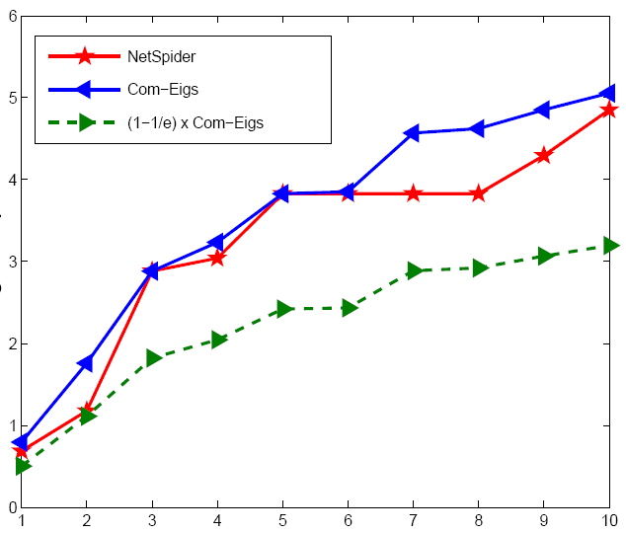
Quality of Netshield
(better)
Optimal
Netshield
Eig-Drop
(1-1/e) x Optimal
# of vaccines

Slide 50
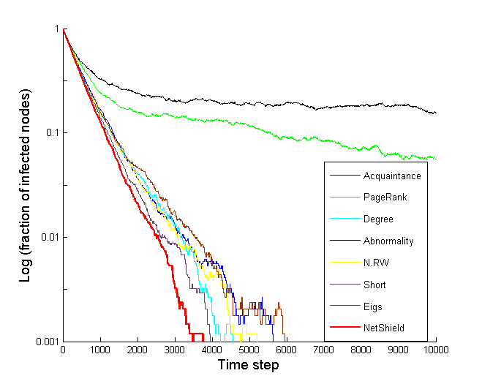
Comparison of Immunization
Log(fraction of infected nodes)
(better)
Abnormality
PageRank
Between (short)
Degree
Between (RW)
Acquaintance
Netshield
Eigs (=HITS)
Time Ticks

Slide 51
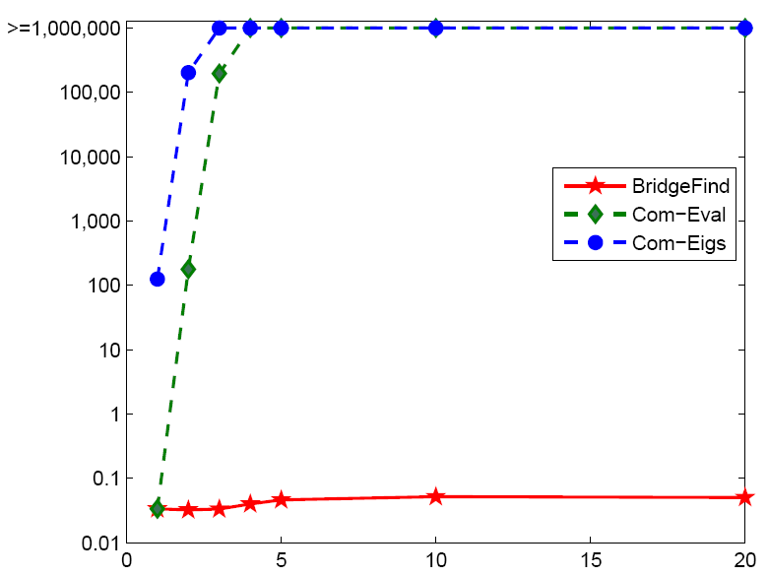
Speed of Netshield
> 10 days
>=1,000,000
Com-Eigs
100,000
10,000
Com-Eval
Time
10,000,000x
1,000
(better)
100
10
Netshield
0.1 seconds
1
0.1
# of vaccines
0.01
NIPS co-authorship Network: 3K nodes, 15K edges
51

Slide 52
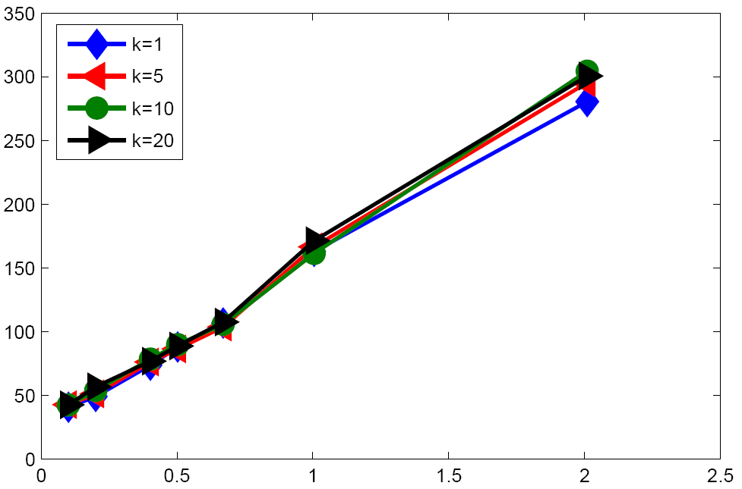
Scalability of Netshield
Time
(better)
# of edges
X 10⁸

Slide 53
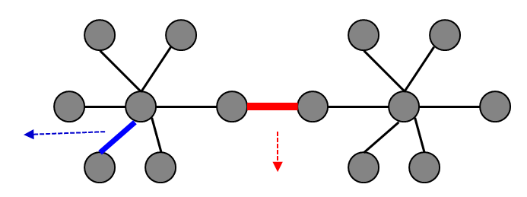
From Node Deletion to Edge Deletion
Given: a graph A, virus prop model and budget k;
Find: delete k ‘best’ edges from A to minimize λ
Bad
Good
Our Solutions: 1st order matrix perturbation again!
  λ - λ_{s} ≈Mv(S)= c ∑_{eєS} u(i_{e})v(j_{e})
Left eigen-score of source
Right eigen-score of target

Slide 54
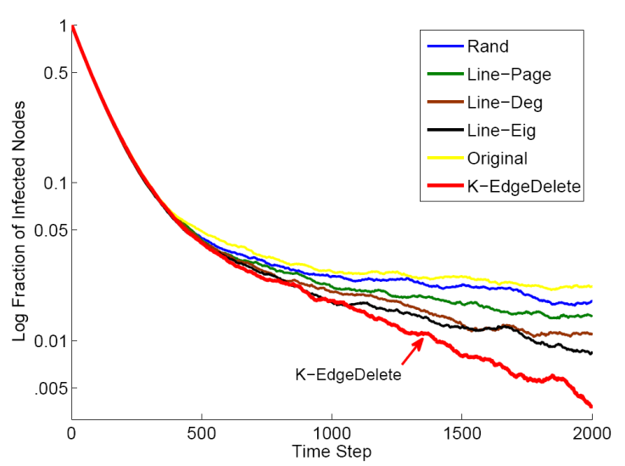
Minimizing Propagation: Evaluations
Log (Infected Ratio)
(better)
Our Method
Time Ticks
Data set: Oregon Autonomous System Graph (14K node, 61K edges)
Aa

Slide 55

Discussions: Node Deletion vs. Edge Deletion
Observations:
  Node or Edge Deletion → λ Decrease
  Nodes on A = Edges on its line graph L(A)
Original Graph A
Line Graph L(A)
Questions?
  Edge Deletion on A = Node Deletion on L(A)?
  Which strategy is better (when both feasible)?

Slide 56
Discussions: Node Deletion vs. Edge Deletion
Q: Is Edge Deletion on A = Node Deletion on L(A)?
A: Yes!
But, Node Deletion itself is not easy:
Theorem: Line Graph Spectrum.
Eigenvalue of A → Eigenvalue of L(A)
Theorem: Hardness of Node Deletion.
Find Optimal k-node Immunization is NP-Hard
56

Slide 57

Discussions: Node Deletion vs. Edge Deletion
Q: Which strategy is better (when both feasible)?
A: Edge Deletion > Node Deletion
(better)
Green: Node Deletion (e.g., shutdown a twitter account)
Red: Edge Deletion (e.g., un-friend two users)

Slide 58
Maximizing Dissemination: Edge Addition
Given: a graph A, virus prop model and budget k;
Find: add k ‘best’ new edges into A.
By 1st order perturbation, we have
  λ_{s} - λ ≈Gv(S)= c ∑_{eєS} u(i_{e})v(j_{e})
So, we are done → need O(n²-m) complexity
Left eigen-score
of source
Right eigen-score
of target
Low Gv
High Gv

Slide 59


Maximizing Dissemination: Edge Addition
λ_{s} - λ ≈Gv(S)= c ∑_{eєS} u(i_{e})v(j_{e})
Q: How to Find k new edges w/ highest Gv(S) ?
A: Modified Fagin’s algorithm
k
#2: Sorting
Targets by v
k+d
#3:
Search
space
Search
space
k
k+d
#1: Sorting
Sources by u
Time Complexity: O(m+nt+kt²), t = max(k,d)
:existing edge

Slide 60

Maximizing Dissemination: Evaluation
Log (Infected Ratio)
(better)
Time Ticks

Slide 61
More on GCO Algorithms
M1: Higher Order Variants
  `Better’ Matrix Perturbation → Better Approximation of Eigen-gap?
  C. Chen, H. Tong, B. Prakash, C. Tsourakakis, T. Eliassi-Rad, C. Faloutsos, D. Chau: Node Immunization on Large Graphs: Theory and Algorithms. IEEE TKDE 2015
M2: Beyond Full & Symmetric Immunity
  Immunizing a node weakens (but not deleting) the incoming (but not the out-going) links
  B. Aditya Prakash, Lada Adamic, Theodore Iwashnya, Hanghang Tong and Christos Faloutsos: Fractional Immunization on Networks. SDM 2013
Notes:
Expand: 1 page for each. (add figure)

Slide 62
More on GCO Algorithms (cont.)
M3: Immunization on Dynamic Graphs
  Optimize connectivity on Time-Varying Graphs (with alternating behavior)
  B. Aditya Prakash, Hanghang Tong, Nicholas Valler, Michalis Faloutsos, Christos Faloutsos: Virus Propagation on Time-Varying Networks: Theory and Immunization Algorithms. ECML/PKDD (3) 2010: 99-114
M4: Manipulating Network Robustness
  Beyond λ: Optimizing an eigen-function of the underlying graph
  Hau Chan, Leman Akoglu, Hanghang Tong: Make It or Break It: Manipulating Robustness in Large Networks. SDM 2014: 325-333

Slide 63
More on GCO Algorithms (cont.)
M5: Robust Network Construction
  How to building a `well-connected’ network, that is robust to external intentional attack, with resource constraint?
  Hui Wang, Wanyun Cui, Yanghua Xiao, Hanghang Tong:Robust network construction against intentional attacks. BigComp 2015: 279-286
M6: Vaccine Distribution with Uncertainty
  Optimizing the connectivity of a ‘noisy’, uncertain graph.
  Yao Zhang and B. Aditya Prakash: Scalable Vaccine Distribution in Large Graphs given Uncertain Data. ICDM 2014
  Code available at: http://people.cs.vt.edu/badityap/CODE/UDAV.zip

Slide 64
More on GCO Algorithms (cont.)
M7: Handling Small Eigen-Gap
  Optimal edge deletion strategy on a graph with small eigen-gap (e.g., social networks), where matrix-perturbation might collapse.
  L. Le, T. Eliassi-Rad and H. Tong: MET: A Fast Algorithm for Minimizing Propagation in Large Graphs with Small Eigen-Gaps. SDM 2015
M8: Source/Target-Specific Connectivity Optimization
  Identifying most important nodes in connecting two nodes, or two groups of nodes
  Hanghang Tong, Spiros Papadimitriou, Christos Faloutsos, Philip S. Yu, Tina Eliassi-Rad: Gateway finder in large graphs: problem definitions and fast solutions. Inf. Retr. 15(3-4): 391-411 (2012)

Slide 65
Roadmap
Motivations and Background
Part I: GCO Measures
Part II: GCO Theories & Algorithms
Part III: GCO Applications
Part IV: Open Challenges & Future Trends

Slide 66
Part III: Applications
A1: Immunization
A2: Optimal Resource Allocation
A3: Optimal Network Demolition: Collective Influence
A4: Diversified Ranking on Graphs
A5: Information Spreading in Context
A6: Vulnerability of Cyber-Physical Systems
A7: Team Member Replacement
A8: Competitive Virus on Composite Networks
A9: Gateway finder

Slide 67
A1: Immunization
Log(fraction of infected nodes)
(better)
Abnormality
PageRank
Between (short)
Degree
Between (RW)
Acquaintance
Netshield
Eigs (=HITS)
Time Ticks
H. Tong, B. Prakash, C. Tsourakakis, T. Eliassi-Rad, C. Faloutsos, D. Chau: On the Vulnerability of Large Graphs. ICDM 2010: 1091-1096
C. Chen, H. Tong, B. Prakash, C. Tsourakakis, T. Eliassi-Rad, C. Faloutsos, D. Chau: Node Immunization on Large Graphs: Theory and Algorithms. IEEE TKDE 2015

Slide 68

A2: Optimal Recourse Allocation
US-Medicare Network
Critical Patient transferring
Move patients → specialized care
→ highly resistant micro-organism → Infection controlling → costly & limited
Q: How to allocate resource to minimize overall spreading?
SARS costs 700+ lives; $40+ Bn; H1N1 costs Mexico $2.3bn; Flu 2013: one of the worst in a decade, 105 children in US.

Slide 69
A2: Optimal Recourse Allocation
Current Method
Out Method
Red: Infected Hospitals after 365 days
B. Aditya Prakash, Lada Adamic, Theodore Iwashnya, Hanghang Tong and Christos Faloutsos: Fractional Immunization on Networks. SDM 2013

Slide 70



A3: Optimal Network Demolition: Collective Influence
(a): the original input network.
(b): removing six (white) nodes w/ highest individual influence scores → GCC of size12.
(c): removing four (white) nodes with highest collective influence→ GCC of size 10.
István A. Kovács & Albert-László Barabási: Network science: Destruction perfected. Nature 524, 38–39, 2015

Slide 71








A4: Diversified Ranking on Large Graphs
Q: Why Diversity?
A1: Uncertainty & Ambiguity in an Information Need
Case 1: Uncertainty from the query
Case 2: Uncertainty from the user
Hanghang Tong, Jingrui He, Zhen Wen, Ravi Konuru, Ching-Yung Lin:
Diversified ranking on large graphs: an optimization viewpoint. KDD 2011: 1028-1036

Slide 72
A4: Why Diversity? (cont.)
A2: Address uncertainty & ambiguity of an information need
  C1: Product search → want different reviews
  C2: Political issue debate → desire different opinions
  C3: Legal search → find ALL relevant cases
  C4: Team assembling → find a set of relevant & diversified experts
A3: Become a better and safer employee
  Better: A 1% increase in diversity → an additional $886 of monthly revenue
  Safer: A 1% increase in diversity → an increase of 11.8% in job retention
Hanghang Tong, Jingrui He, Zhen Wen, Ravi Konuru, Ching-Yung Lin:
Diversified ranking on large graphs: an optimization viewpoint. KDD 2011: 1028-1036

Slide 73

A4: Our Solutions (10 sec. introduction!)
Problem 1 (Evaluate/measure a given top-k ranking list)
A1: A weighted sum between relevance and similarity
Problem 2 (Find a near optimal top-k ranking list)
A2: A greedy algorithm (near-optimal, linear scalability)
relevance
weight
diversity
9
10
9
10
2
12
2
12
1
8
1
8
3
11
3
11
4
4
B: Personalized
Graph
A: Original Graph
6
6
5
5
Aa
73
7
7

Slide 74
A Special Case of Dragon = Generalized Netshild
r = B r
Fact 1: The largest eigenvalue of B is 1
Fact 2: r is the corresponding right eigenvector of B
Fact 3: The corresponding left eigenvector of B is 1
Dragon (w=2) = Netshield on directed graphs
For w=2, g(S)~=drop in the largest eigenvalue of B
9
10
2
12
1
8
Intuition: find k nodes to disconnect the
personalized graph B as much as possible
3
11
4
5
6
7
Hanghang Tong, Jingrui He, Zhen Wen, Ravi Konuru, Ching-Yung Lin:
Diversified ranking on large graphs: an optimization viewpoint. KDD 2011: 1028-1036

Slide 75




A4: Experimental Results
Quality
Budget
An Illustrative Example
Compare w/ alternative choices
Time
Time
Budget
Opt. Quality
Quality-Time Balance
Scalability
Hanghang Tong, Jingrui He, Zhen Wen, Ravi Konuru, Ching-Yung Lin:
Diversified ranking on large graphs: an optimization viewpoint. KDD 2011: 1028-1036
75

Slide 76


A5: Information Spreading in Context
Micro-Behavior
Q1: What does information spreading depend on?
Macro-Behavior
Data: 8000+ IBM employees emails, 2000+ Fw threads, information about the individuals (performance, dept, job role), content of emails
Q2: How does the tree look Like
(depth, width, size), and why?
Dashun Wang, Zhen Wen, Hanghang Tong, Ching-Yung Lin, Chaoming Song, Albert-László Barabási: Information spreading in context. WWW 2011: 735-744

Slide 77

A5: Information Spread (whether or not) vs. Content
A
B
C
Aug 5, 09:30:12 “date request”
Aug 5, 09:53:00 “Fw: date request”
Information is more likely non-expert → expert
Dashun Wang, Zhen Wen, Hanghang Tong, Ching-Yung Lin, Chaoming Song, Albert-László Barabási: Information spreading in context. WWW 2011: 735-744

Slide 78


A5: The Structure of Information Spreading
Width
Depth
1) The trees are fat and shallow (instead of thin and deep as in Kleinberg's chain-letter setting)
2) Can be explained by a simple branch model (w/ decaying branching factors)
Dashun Wang, Zhen Wen, Hanghang Tong, Ching-Yung Lin, Chaoming Song, Albert-László Barabási: Information spreading in context. WWW 2011: 735-744

Slide 79


A6: Vulnerability of Cyber-Physical Systems
A Two-layered CPS
  Blue: communication networks
  Red: Power grid
  Dashed line: cross-layer inter-dependency
Examples of Infrastructure Interdependencies
Q: which node(s) and/or link(s) dysfunctions will lead to a catastrophic failure of the entire system?
Rinaldi, Steven M., James P. Peerenboom, and Terrence K. Kelly. "Identifying, understanding, and analyzing critical infrastructure interdependencies." Control Systems, IEEE 21.6 (2001): 11-25.
Nguyen, Duy T., Yilin Shen, and My T. Thai. "Detecting critical nodes in interdependent power networks for vulnerability assessment." Smart Grid, IEEE Transactions on 4.1 (2013): 151-159.
Vespignani, Alessandro. "Complex networks: The fragility of interdependency." Nature 464.7291 (2010): 984-985.

Slide 80

A7: Team Member Replacement
Liangyue Li, Hanghang Tong, Nan Cao, Kate Ehrlich, Yu-Ru Lin, Norbou Buchler:Replacing the Irreplaceable: Fast Algorithms for Team Member Recommendation. WWW 2015: 636-646

Slide 81

A7: Team Member Replacement
Liangyue Li, Hanghang Tong, Nan Cao, Kate Ehrlich, Yu-Ru Lin, Norbou Buchler:Replacing the Irreplaceable: Fast Algorithms for Team Member Recommendation. WWW 2015: 636-646

Slide 82

A7: Team Member Replacement
Liangyue Li, Hanghang Tong, Nan Cao, Kate Ehrlich, Yu-Ru Lin, Norbou Buchler:Replacing the Irreplaceable: Fast Algorithms for Team Member Recommendation. WWW 2015: 636-646

Slide 83

A7: Team Member Replacement
Liangyue Li, Hanghang Tong, Nan Cao, Kate Ehrlich, Yu-Ru Lin, Norbou Buchler:Replacing the Irreplaceable: Fast Algorithms for Team Member Recommendation. WWW 2015: 636-646

Slide 84



A8: Competitive Virus on Composite Networks
Q: Which virus will win?
  `virus’: smartphone malware, memes, ideas
A: if λ₁> λ₂ V1 will win.
  λ₁ and λ₂: leading eigen-values of system matrices.
Results
An example of composite network: a single set of nodes with two distinct sets of links
Virus Model: S I₁ I₂ S
Xuetao Wei, Nicholas Valler, B. Aditya Prakash, Iulian Neamtiu, Michalis Faloutsos, Christos Faloutsos: Competing Memes Propagation on Networks: A Network Science Perspective. IEEE Journal on Selected Areas in Communications 31(6): 1049-1060 (2013)

Slide 85


A9: Gateway Finder
Problem Definition: Given a source (s) or a source group; and a target (t) or a target group,
  Q1 (Metric): how to measure the gateway-ness for a subset of nodes (I)?
  Q2 (Algorithm): how to find a subset of k nodes with highest gateway-ness score?
Solutions: Find the set whose removal causes maximal decrease of the proximity from source to target (e.g., block most paths).
Hanghang Tong, Spiros Papadimitriou, Christos Faloutsos, Philip S. Yu, Tina Eliassi-Rad: Gateway finder in large graphs: problem definitions and fast solutions. Inf. Retr. 15(3-4): 391-411 (2012)

Slide 86
Part IV: Future Trends
N1: Learn k in GCO Problem
N2: Sense-Making of GCO: How/Why?
N3: GCO Tracking & Attribution
N4: GCO on Multi-layered Networks
N5: Min-Max GCO Problem
N6: Super-Robust Network Problem
N7: Optimal Graph Construction Problem
N8: GCO Scalability: Challenges & Opportunities

Slide 87

N1: Learn k in GCO
Graph Connectivity Optimization (GCO) - This Tutorial
Given:
(1) an initial graph
(2) a graph operation (e.g., deleting k nodes, adding k new links)
(3) a mining task
Find:
an ‘optimal’ graph
Q: what is the minimum k, to reduce the epidemic threshold below 1, given the strength of the virus and connectivity of the population?

Slide 88



N2: Sense-Making of GCO:
What/Who → How/Why?
Current: A Typical GCO Instance
  Given: a social network,
  Find: who or which links are the most important, in bridging different communities?
Next: From Who/Who to How/Why
  Q1: Given an critical power-line in power-grid, explain why it is important (in maintaining the graph connectivity)
  Q2: Given an influential author in scholarly network, find how s/he influence other researchers and/or fields?
Retweeting Graph in Chinese Weibo
Reversed Citation
Graph

Slide 89


N2: A Flow-based Summarization Solution
The influence graph of “Stochastic High-Level Petri Net and Applications”
Lei Shi, Hanghang Tong, Jie Tang, Chuang Lin: Flow-Based Influence Graph Visual Summarization. ICDM 2014: 983-988

Slide 90



N3: GCO Tracking & Attribution
Observations
  #1: Graphs are changing over time
  #2: Many graph connectivity measures can be expressed as an eigen-function of the adjacency matrix
Solutions: Tracking eigen-function
Results
C. Chen and H. Tong: “Fast Eigen-Functions Tracking on Dynamic Graphs”. SDM 2015

Slide 91



N4: GCO on Multi-layered Networks
A four-layered network
layer-layer
dependency network
A Multi-layered Network Model (Mulan)
  A Quintuple: aa
Q: How to find an optimal node set in the control layer, to minimize the connectivity of the target layer(s)?
C. Chen, J. He, N. Bliss and H. Tong: “On the Connectivity of Multi-layered Networks: Models, Measures and Optimal Control” ICDM 2015.

Slide 92


N5: Min-Max GCO Problem
(Angels & Demons)
Given: two inter-connected networks (or two inter-connected components within the same network);
Find: the optimal graph operation, that
  minimizes the connectivity of the (adversarial) network, and
  maximizes the connectivity of the other network (the one we want to protect).
Maximize
Minimize

Slide 93

N6: Super-Robust Network
Observations (Nature 2000):
  Scale-free Networks (e.g., power-law): resilient to random failure, but vulnerable to targeted attack
  Exponential Networks (e.g., ER, Small-World model): resilient to targeted attacks.
Q1: How to design a robust network that is resilient to both failure and attacks?
Q2: If we know the type of attack (e.g., HDA, or even based on GCO algorithms), How to tailor the GCO-defending algorithms (e.g., knowing your enemies)?
X: fraction of removed nodes
Y: diameter of the residual network
E: ER model; SF: scale-free
Blue: (random) failure
Red: (intentional) attack
Albert, Réka, Hawoong Jeong, and Albert-László Barabási. "Error and attack tolerance of complex networks." nature 406.6794 (2000): 378-382.
István A. Kovács & Albert-László Barabási: Network science: Destruction perfected. Nature 524, 38–39, 2015

Slide 94



N7: Optimal Graph Construction
Q: What if the initial graph does not exist?
Robust Network Construction again intentional attacks (e.g., HDA)
  Given: (1) the number of nodes n of the graph, and (2) its desired degree vector d (i.e., node capacity);
  Output: a graph A with (1) n nodes, (2) the maximal robustness, (3) deg(A) = d
An Effective Heuristic
  H1: Avoid disassortative
  mix by degree
  H2: Large loop coverage
Hui Wang, Wanyun Cui, Yanghua Xiao, Hanghang Tong: Robust network construction against intentional attacks. BigComp 2015: 279-286

Slide 95
N8: GCO Scalability:
Challenges & Opportunities
Challenges: How to Scale-up & Speed-up
  E1: O(m) or better on a single machine
  E2: Parallelism (implementation, decouple, analysis)
Opportunities:
  Solving GCO problems trivially by scale?
  Conjecture: when the initial graph is big enough, (1) adding any new links will make little improvement, and (2) the graph becomes impossible to demolish with any limited budget.
  Is this true? If so, where is the tipping point?
- 95 -

Slide 96






















Acknowledgement
Lada A. Adamic, Leman Akoglu, Albert-László Barabási, Norbou Buchler, Nadya Bliss, Nan Cao, Polo Chau, Tina Eliassi-Rad, Kate Erhlich, Christos Faloutsos, Michalis Faloutsos, Jingrui He, Theodore J. Iwashyna, Yu-Ru Lin, Qiaozhu Mei, B. Aditya Prakash, Lei Shi, Chaoming Song, Boleslaw K. Szymanski, Jie Tang, Dashun Wang, Yanghua Xiao, Lei Xie, Lei Ying

Slide 97
Reference
Hanghang Tong, B. Aditya Prakash, Tina Eliassi-Rad, Michalis Faloutsos, Christos Faloutsos: Gelling, and melting, large graphs by edge manipulation. CIKM 2012: 245-254
Hui Wang, Wanyun Cui, Yanghua Xiao, Hanghang Tong: Robust network construction against intentional attacks. BigComp 2015: 279-286
Lei Shi, Hanghang Tong, Jie Tang, Chuang Lin: Flow-Based Influence Graph Visual Summarization. ICDM 2014: 983-988
B. Aditya Prakash, Lada Adamic, Theodore Iwashnya, Hanghang Tong and Christos Faloutsos: Fractional Immunization on Networks. SDM 2013
Hau Chan, Leman Akoglu, Hanghang Tong: Make It or Break It: Manipulating Robustness in Large Networks. SDM 2014: 325-333

Slide 98
Reference
Hanghang Tong, Spiros Papadimitriou, Christos Faloutsos, Philip S. Yu, Tina Eliassi-Rad: Gateway finder in large graphs: problem definitions and fast solutions. Inf. Retr. 15(3-4): 391-411 (2012)
Hanghang Tong, Jingrui He, Zhen Wen, Ravi Konuru, Ching-Yung Lin: Diversified ranking on large graphs: an optimization viewpoint. KDD 2011: 1028-1036
Nicholas Valler, B. Aditya Prakash, Hanghang Tong, Michalis Faloutsos, Christos Faloutsos: Epidemic Spread in Mobile Ad Hoc Networks: Determining the Tipping Point. Networking (1) 2011: 266-280
Dashun Wang, Zhen Wen, Hanghang Tong, Ching-Yung Lin, Chaoming Song, Albert-László Barabási: Information spreading in context. WWW 2011: 735-744
Hanghang Tong, B. Aditya Prakash, Charalampos E. Tsourakakis, Tina Eliassi-Rad, Christos Faloutsos, Duen Horng Chau: On the Vulnerability of Large Graphs. ICDM 2010: 1091-1096

Slide 99
Reference
Yao Zhang and B. Aditya Prakash: Scalable Vaccine Distribution in Large Graphs given Uncertain Data. ICDM 2014
Code available at: http://people.cs.vt.edu/badityap/CODE/UDAV.zip
L. Le, T. Eliassi-Rad and H. Tong: MET: A Fast Algorithm for Minimizing Propagation in Large Graphs with Small Eigen-Gaps. SDM 2015
István A. Kovács & Albert-László Barabási: Network science: Destruction perfected. Nature 524, 38–39, 2015
Rinaldi, Steven M., James P. Peerenboom, and Terrence K. Kelly. "Identifying, understanding, and analyzing critical infrastructure interdependencies." Control Systems, IEEE 21.6 (2001): 11-25.
Nguyen, Duy T., Yilin Shen, and My T. Thai. "Detecting critical nodes in interdependent power networks for vulnerability assessment." Smart Grid, IEEE Transactions on 4.1 (2013): 151-159.

Slide 100
Reference
Xuetao Wei, Nicholas Valler, B. Aditya Prakash, Iulian Neamtiu, Michalis Faloutsos, Christos Faloutsos: Competing Memes Propagation on Networks: A Network Science Perspective. IEEE Journal on SAC 31(6): 1049-1060 (2013)
Liangyue Li, Hanghang Tong, Nan Cao, Kate Ehrlich, Yu-Ru Lin, Norbou Buchler:Replacing the Irreplaceable: Fast Algorithms for Team Member Recommendation. WWW 2015: 636-646
C. Chen, H. Tong, B. Prakash, C. Tsourakakis, T. Eliassi-Rad, C. Faloutsos, D. Chau: Node Immunization on Large Graphs: Theory and Algorithms. IEEE TKDE 2015
B. Aditya Prakash, Hanghang Tong, Nicholas Valler, Michalis Faloutsos, Christos Faloutsos: Virus Propagation on Time-Varying Networks: Theory and Immunization Algorithms. ECML/PKDD (3) 2010: 99-114

